Slide 1
Outdoor First Aid
(Level 3)
Day 2
Course tutor: _______________________

Slide 2

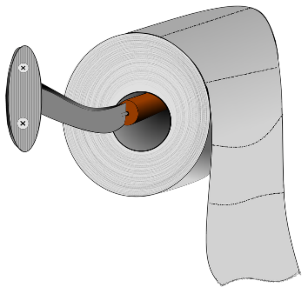
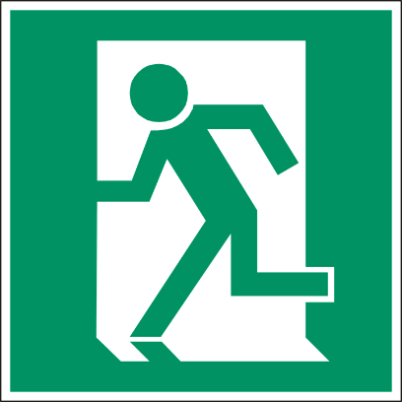
House Keeping
Fire Exits
Toilets
Smoking areas
Mobile phones
Schedule for today

Slide 3
Learning Outcomes
By the end of the session you will be able to:
Understand the role and responsibilities of a first aider.
Assess an incident.
Manage a casualty who has fainted.
Provide first aid to a casualty with heat or cold injuries
Provide first aid to a casualty with a suspected major illness.
Administer first aid to a casualty with suspected head and spinal injuries.
Understand how to administer first aid to a casualty who has been bitten or stung.

Slide 4
Roles and Responsibilities of the First Aider
Section 1

Slide 5
Roles and Responsibilities of the First Aider
Recap - Roles of the First Aider:
Preserve Life – Administer immediate effective first aid to a casualty in order to save life.
Prevent the Condition from Worsening – Recognising and treating the cause will assist with preventing the condition from worsening.
Promote Recovery – Administer ongoing treatment and offer constant support until the arrival of qualified medical assistance.

Slide 6
Roles and Responsibilities of the First Aider
Recap - Responsibilities
The responsibilities of the first aider will be dependent on specific workplace requirements, these could include:
Ensuring the first aid equipment is fit for purpose
Arriving at the scene
Ensuring the scene is safe
Contacting the emergency services
Prioritising the treatment of casualties
Clearing up after an incident
Incident reporting and recording

Slide 7
Roles and Responsibilities of the First Aider
In your area or outdoors…
Do you think there are any additional roles and responsibilities that the first aider will have?

Slide 8

Roles and Responsibilities of the First Aider
First Aid in Public
When dealing with an incident in public, the First Aider must:
Always try to remain calm
Take charge of the situation
Do not allow others to encircle you if possible
Arrange privacy for the casualty as soon as possible
Ensure the casualties possessions remain safe
Allow First Aiders who are trained at a higher level take control if appropriate

Slide 9
Roles and Responsibilities of the First Aider
When the emergency services cannot reach you promptly
When dealing with an incident over a longer period of time, the First Aider must:
Ensure the emergency services know your exact location
  Landmarks, road names, buildings, phone signal (take special note of battery life)
Ensure you are clearly visible to the emergency services
  Visible from the air as well as the ground
Ensure you are aware of how long the emergency services will take
Be prepared for the emergency services not being able to find you

Slide 10
Fainting
Section 2

Slide 11
Fainting
A lack of blood, sugar or oxygen to the brain will cause a casualty to faint. There may be other issues such as seeing blood and trauma (including the sight of needles) which could cause others to faint nearby.
Recognition
Pale, cold and clammy
Collapsing to the floor
Treatment
Lay on the floor and raise legs above the body
Seek further medical assistance if required
When casualty regains consciousness, ask if they suffer any ailments which can cause them to faint (e.g. low blood pressure, low blood sugar etc.)

Slide 12
Hypothermia
Section 1

Slide 13
Hypothermia
Hypothermia
When the body is exposed to prolonged cold caused by weather, water etc. the bodies core temperature will drop. If the bodies core temperature drops below 35°C then the onset of hypothermia will occur.
Recognition
Pale, cold skin
Shivering at onset then the muscles will stiffen as the condition gets worse
Lethargic
Breathing, speech and pulse slowing
Disorientation and confusion
Diminishing level of response leading to unconsciousness and death
Treatment
Remove the casualty from the source of the cold
Cover the casualty with blankets or ensure the room is warm (approx. 25°C)
If the casualty is outdoors insulate the casualty from the ground
Give warm drinks
Monitor their condition
Call for medical assistance (999/112) if there is no improvement or is elderly or young

Slide 14
Frostbite
Section 2

Slide 15
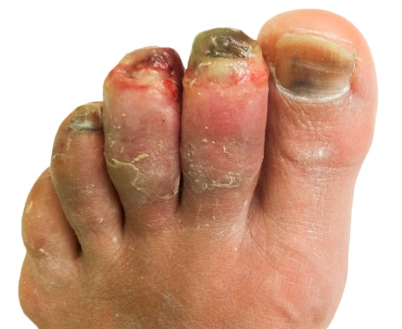
Frostbite
Frostbite
Frostbite is a serious medical condition which normally affects the extremities (fingers and toes) by causing damage to the skin due to freezing, this will eventually cause the skin to die.
Recognition
Prolonged exposure to extremely cold conditions
Pins and needles in the first stages of frostbite
Hardening and stiffening of the skin becoming painful
Skin will become purple/black and extremely painful in the later stages of frostbite
Treatment
Remove the casualty from the source of the cold
Use body heat to warm extremities (e.g. hands under arm pits)
Cover the body and extremities with blankets
Call for an ambulance immediately (999/112)

Slide 16
Heat Exhaustion
Section 3

Slide 17
Heat Exhaustion
Heat Exhaustion
Heat exhaustion is caused by the bodies core temperature rising above 37°C. In attempt to cool down, excessive sweating occurs causing the body to loose vital fluids and salts.
Recognition
Hot flushed skin
Excessive sweating
Fatigue
Headache, nausea and vomiting
Rapid pulse
Confusion
Urinating less (urine dark in colour)
Treatment
Move the casualty to a cool place
Give the casualty a sports energy drink or water to rehydrate
Remove any excessive clothing
Monitor the casualty’s response levels
Call for medical assistance (999/112)

Slide 18
Heatstroke
Section 4

Slide 19
Heatstroke
Heatstroke
Heatstroke is when the hypothalamus (the bodies temperature regulator) ceases working and the body can not cool down through normal actions such as sweating. The core temperature rises above 40°C which is very dangerous.
Recognition
High temperature and dry skin
Nausea, dizziness and vomiting
Intense headache
Lower response levels
Rapid pulse and breathing
Muscle cramps
Possibly unconscious
Treatment
Move the casualty to a cool place
Call for medical assistance immediately (999/112)
Give the casualty a sports energy drink or water to rehydrate
Try to cool the skin by applying a damp towel or spraying with water
Be prepared to carry out basic life support

Slide 20
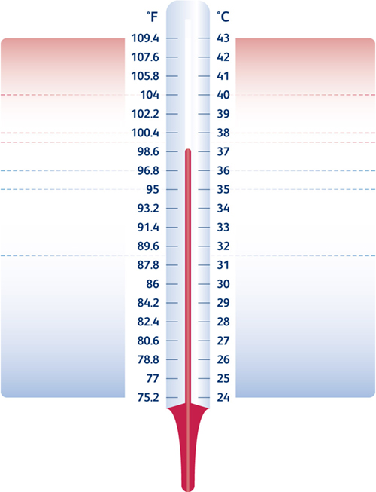
Unconsciousness / fitting
Confused / restless
Heat Stroke
Headache, dizzy, uncomfortable
Strong bounding pulse
Flushed dry skin, hot to touch
Cramps in stomach / arms / legs
Heat Exhaustion
Pale sweaty skin
Nausea / loss of appetite
Normal Body Temperature
Shivering
Fatigue, slurred speech
Confusion, forgetfulness
Mild Hypothermia
Shivering stops, muscle rigidity
Very slow, very weak pulse
Noticeable drowsiness
Severe reduction in response levels
Unconsciousness
Dilated pupils
Pulse undetectable
Severe Hypothermia
Appearance of death
Death

Slide 21
Comfort Break

Slide 22
Hypoglycaemia and Hyperglycaemia
Section 9

Slide 23
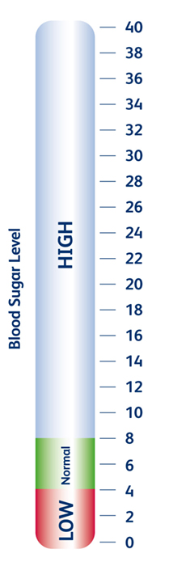
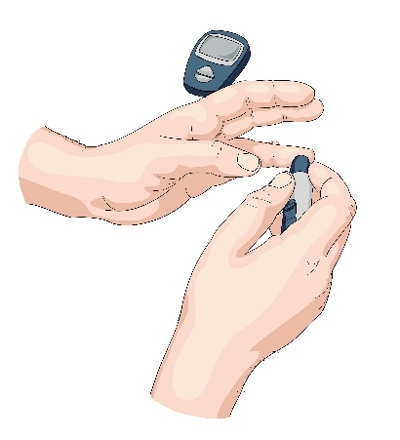

Hypoglycaemia and Hyperglycaemia
Diabetes
Diabetes is caused by a failures of the bodies ability to produce insulin which regulates the blood sugar levels.
Insulin
Sugar

Slide 24
Hypoglycaemia and Hyperglycaemia
Hypoglycaemia
This is caused when the blood sugar level is too low.
Recognition
Blurred vision
Hunger
Tired, confused and feeling faint
Increased heart rate
Headache
Tingling sensations
Noticeable change in personality
Treatment
Sit the casualty down, calm and reassure
Ask the casualty to take a 15 – 20g glucose tablet, sugar or sugary drink
If there is no improvement in the casualties condition call for an ambulance (999/112)
Monitor the casualties condition, if the casualty becomes unconscious be prepared to carry out basic life support

Slide 25
Hypoglycaemia and Hyperglycaemia
Hyperglycaemia
This is caused when the blood sugar level is too high.
Recognition
Sweet fruity smelling breath
Increased need to urinate
Increased thirst
Dry mouth
Loss of appetite
Tiredness and confused
Treatment
Sit the casualty down, calm and reassure
Encourage the casualty to use their medication
If they have not been previously been diagnosed with diabetes then call form medical assistance (999/112)
Monitor the casualties condition, if the casualty becomes unconscious be prepared to carry out basic life support

Slide 26
Poisoning
Section 10

Slide 27
Poisoning
Poison
A poison is a foreign substance that enters the body by means of ingestion inhalation, absorption or injection which will interfere the normal bodies function.
Recognition
Pains in the stomach
Impaired vision
Increased/decreased heart rate
Smell of fumes or chemicals
Burns and rashes
Nausea and vomiting
Difficulty in breathing
Treatment
Call for ambulance (999/112)
Ensure the scene is safe
Remove the cause or remove the casualty from the scene
Identify the poison if possible and provide the source to the ambulance crew when they arrive
Be prepared to carry out basic life support

Slide 28
Asthma
Section 11

Slide 29
Asthma
Asthma
Asthma is a condition that affects the airway by inflaming it making it difficult to breathe. There are many triggers of asthma which include; dust, pollen and pet hair.
Recognition
Breathlessness
Wheezing
Tightness around the chest
Bouts of coughing
Cyanosis (blue lips, ears and nose)
May be unconscious
Treatment
Sit the casualty down on a chair or floor away from the cause of the attack and let them get in a comfortable position
Encourage the casualty to take their medication (inhaler)
Calm and reassure the casualty
If the attack is prolonged call for medical assistance (999/112)
Be prepared to carry out basic life support

Slide 30


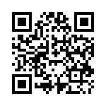
Asthma
Asthma
Salbutamol inhalers (blue) can now be kept in educational establishments first aid boxes, provided they follow the guidance.
Reference:
NHS Nottingham City Clinical Commissioning Group

Slide 31
Asthma
Hyperventilation (HVS)
Hyperventilation syndrome (HVS) is a name given to a collection of physical and emotional symptoms, largely brought about by hyperventilation. This happens when we over-breathe.
Recognition
Breathlessness / fast breathing
Tightness around the chest
Tingling (e.g. in fingers, arms, mouth)
Muscle stiffness
Trembling in hands
Dizziness, blurred vision, faintness
Headaches
Treatment
Sit the casualty down on a chair or floor and let them get in a comfortable position
Calm and reassure the casualty
Encourage the casualty to slow their breathing
If the attack is prolonged call for medical assistance (999/112)

Slide 32
Head Injuries
Section 5

Slide 33
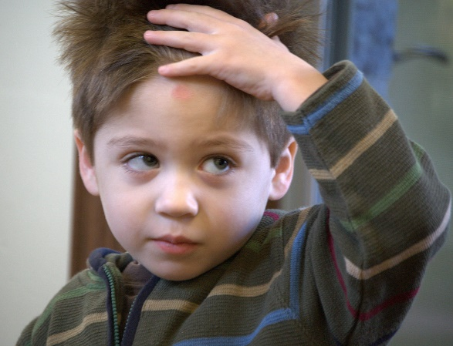
Head Injuries
Head Injury
Head injuries have the potential to be life threatening and therefore casualties should always be examined by qualified medical personnel.
Head injuries are classes into the following:
Concussion
Compression
Fractured skull
Stroke

Slide 34
Head Injuries
Concussion
Concussion is the shaking of the brain caused by a blow to the head which causes a temporary disturbance of normal brain activity.
Recognition
Possible loss of consciousness
Dizziness and nausea
Headache
Brief loss of memory
Blurred vision
Treatment
Treat any bleeding
Call for medical assistance (999/112)
Lay the casualty down on a flat surface and raise the head and shoulders
Monitor the casualty and be prepared to carry out basic life support

Slide 35
Head Injuries
Compression
Compression is a build up of pressure on the brain caused by accumulation of blood or swelling.
Recognition
Intense headache
Drowsiness
Unequal pupil sizes
Slow, strong pulse
Weakness or paralysis down one side of the body
Noisy breathing
Treatment
Treat any bleeding
Call for medical assistance (999/112)
Lay the casualty down on a flat surface and raise the head and shoulders
Monitor the casualty and be prepared to carry out basic life support

Slide 36
Head Injuries
Fractured Skull
Can ether be open or closed; caused by a blow to the head.
Recognition
Associated wound
Tenderness and pain
Depression or deformity of the skull
Bruising and swelling at the site of the injury
Presence of cerebral spinal fluid from ears and nose
Treatment
Treat any bleeding
Call for medical assistance (999/112)
Lay the casualty down on a flat surface and raise the head and shoulders
Monitor the casualty and be prepared to carry out basic life support

Slide 37
Head Injuries
Stroke
A stroke is ether short term or permanent damage to the brain and body. If you suspect a stroke you must act FAST.
Recognition
FACE – has the face dropped on one side
ARM – can the person raise both arms?
SPEECH – can the person speak clearly and understand what you say?
TIME to call 999/112 – early treatment can help prevent further damage
Treatment
Call for an ambulance immediately (999/112)
Lay casualty down with head and shoulders raised
If unconscious place in recovery position
Loosen any restrictive clothing
Monitor airway and breathing and be prepared to perform basic life support

Slide 38
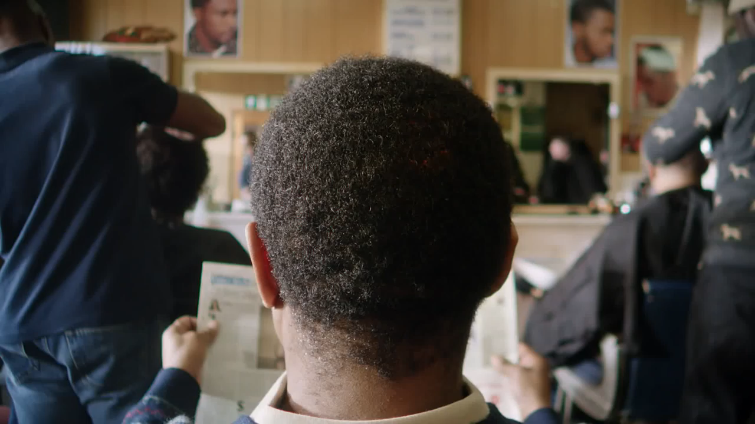
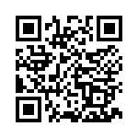
Head Injuries
Stroke
Reference:
NHS & Stroke Association

Slide 39
Spinal Injuries
Section 4

Slide 40
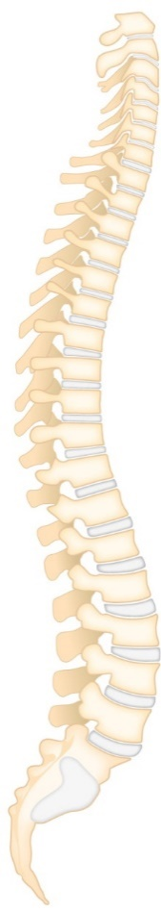
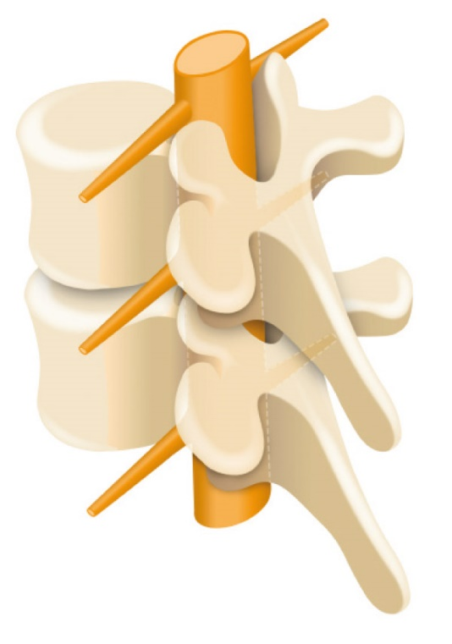
Fractures and Dislocations
Spinal Injury
Spinal injuries are very serious as the they may cause paralysis or even death.
7 Cervical
12 Thoracic
5 Lumbar
5 Fused Sacral

Slide 41
Fractures and Dislocations
Spinal Injury
Spinal injuries are very serious as the they may cause paralysis or even death.
Recognition
Unusual position of the head or body
Pain at the site of the injury
Lack of mobility
Weakness and tingling sensations
Loss of bowl or bladder control
Signs of shock
Treatment
Call for medical assistance (999/112)
Keep the casualty in the position that you found them and immobilise the head and neck
Reassure the casualty and ask them to remain still
Keep the casualty warm
Keep monitoring the casualties airway and breathing
Be prepared to perform basic life support

Slide 42
Bites and Stings
Section 15

Slide 43
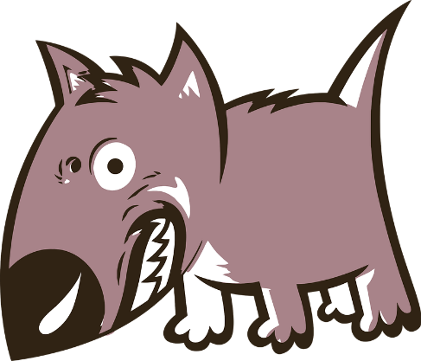
Bites and Stings
Animal and Human Bites
Serious animal and human bites can get infected if they're not checked and treated quickly.
Always seek medical advice if you have been bitten by an animal or person and the bite has broken the skin.
People and animals have a lot of bacteria in their mouths, which can cause an infection if a bite breaks the skin.
These infections are rarely serious if treated quickly, but occasionally they can spread to the blood or other parts of the body.
Serious infections such as tetanus and rabies are extremely rare in the UK, but it's important to get serious bites looked at as treatment to prevent these infections may be recommended.

Slide 44
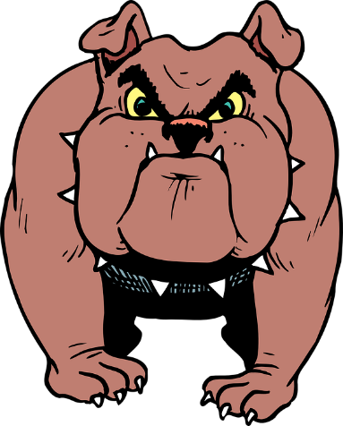
Bites and Stings
Treatment – Animal and Human Bites
Clean the wound immediately by running warm tap water over it for a couple of minutes – it's a good idea to do this even if the skin does not appear to be broken
Remove any objects from the bite, such as teeth, hair or dirt
Encourage the wound to bleed slightly by gently squeezing it, unless it's already bleeding freely
If the wound is bleeding heavily, put a clean pad or sterile dressing over it and apply pressure
Dry the wound and cover it with a clean dressing or plaster
Take painkillers if you're in pain, such as paracetamol or ibuprofen – children under 16 years old should not take aspirin
Seek medical advice, unless the wound is very minor
If the bite has severed a body part like a finger or ear, wash it with tap water, wrap it in clean tissue, and store it in a plastic bag surrounded by ice so it can be transported to hospital.

Slide 45

Bites and Stings
Insect Bites
Insect bites and stings are common and usually only cause minor irritation. However, some stings can be painful and trigger a serious allergic reaction.
Recognition
Skin around bite will appear red, swollen and itchy
Severe reactions will appear as anaphylactic shock
Treatment
Remove the sting by scraping away using hard surface such as finger nails or credit card etc. (Do not pinch or use tweezers)
Wash the affected area with soap and water
Place a cold compress (a flannel or cloth cooled with cold water) over the affected area to reduce swelling
Call 999/112 if a severe reaction occurs

Slide 46
Comfort Break

Slide 47
Casualty Handling and Secondary Survey
Section 12

Slide 48
Casualty Handling and Secondary Survey
D. R. A. B. C. D. (Primary Survey) - Recap
Danger
Response
Airway
Breathing
Call 999 / Circulation
Defibrillation
Prior to approaching the casualty, ensure the safety of the casualty, yourself and any bystanders.
Check the casualty for response by asking the casualty if they are ok and tap them on their shoulder.
Place the casualty on their back. Open the airway using the head tilt and chin lift method.
Place your cheek next to the casualties mouth; look, listen and feel for normal breathing for 10 seconds.
Ask a helper to call for medical assistance.
Send someone to get an AED if available and start CPR.
If an AED arrives, switch it on and follow the prompts.
An AED is used in conjunction with CPR.

Slide 49
Casualty Handling and Secondary Survey
Prioritising the Treatment of the Casualties - Recap
After conducting a primary survey and contacting the emergency services, casualties should be placed in an order of priority and treated accordingly. This order is as follows:
Breathing
Bleeding
Bones or Burns
Other conditions

Slide 50
Casualty Handling and Secondary Survey
Level of Consciousness - Recap
The Glasgow coma scale (GCS) is how medical professionals determine how conscious a casualty is. A simplified version of this is as follows:
A
V
P
U
Alert
Voice
Command
Question
Pain
When touched
When moved
Unresponsive

Slide 51
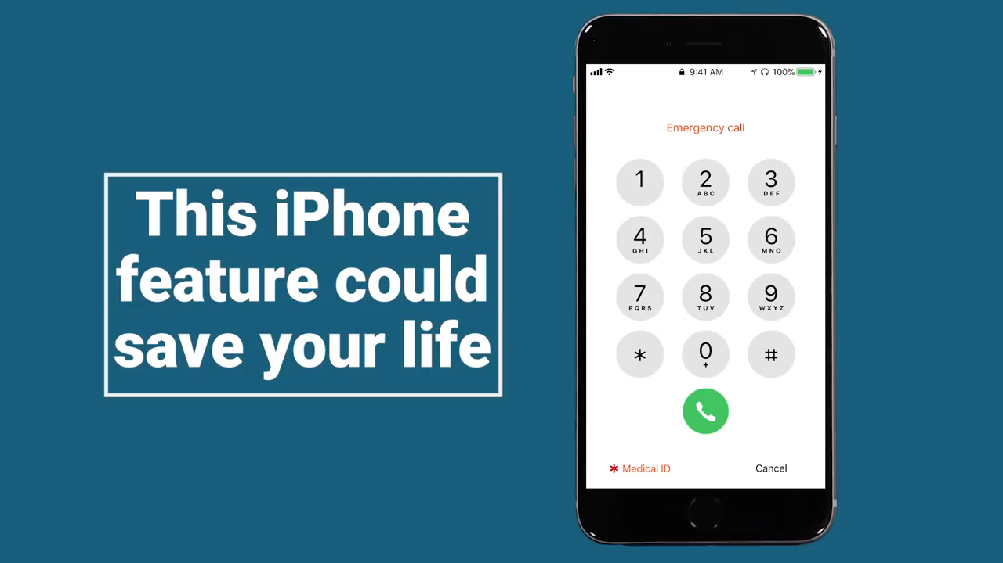
Emergency Medical Information – Mobile Devices

Slide 52
Casualty Handling and Secondary Survey
Secondary Survey
If the casualty is breathing normally after you check for breathing in your primary survey you should contact the emergency services and then perform a secondary survey.
This examination will help you as the first aider gather more information from the casualty.
Talk to the casualty throughout the survey to reassure them and to tell you if they have any pain or discomfort.

Slide 53
Casualty Handling and Secondary Survey
Secondary Survey
Head and Face
Inspect the casualties head looking for obvious signs of injury.
Remove spectacles and gently feel around the head and face for any bleeding, swelling or depressions.
Look in the ears and nose for signs of bleeding or the presence of cerebrospinal fluid (CSF).
Gently open the eye lids together and check the pupils for any reaction to light.
Smell the breath for any distinct odours e.g. alcohol.
Feel the forehead with the back of your hand to check temperature – does it feel normal?

Slide 54
Casualty Handling and Secondary Survey
Secondary Survey
Neck
Loosen any restrictive clothing.
Gently feel around the back of the neck and spinal area to check for bleeding, swelling or deformity.
Check for medical alert necklaces.
Take the pulse in the neck quickly – Is it fast, slow, irregular? What does this information tell you?

Slide 55
Casualty Handling and Secondary Survey
Secondary Survey
Chest and Shoulders
Gently feel around the shoulders to check for signs of deformity and bleeding.
Check the chest for signs of deformity and bleeding.
Abdomen
Gently check the abdomen for signs of bleeding, swelling or unnatural softness.
If you suspect the casualty has any of the above check the stomach for any bruising if possible.

Slide 56
Casualty Handling and Secondary Survey
Secondary Survey
Spine
Check as much of the spine as possible without moving the casualty.
Feel for any tenderness or deformity as well as signs of bleeding.
Pelvis
Check the hips and pelvis for deformity, unnatural positioning or bleeding.

Slide 57
Casualty Handling and Secondary Survey
Secondary Survey
Legs and Feet
Check the legs and feet for bleeding, unnatural positioning, swelling and deformity.
Check the pockets for any form of identification, mobile devices which could be used to contact the emergency services, medication or any other object which may cause discomfort when moving them.
Arms and Hands
Check down the arms feeling for any deformity, bleeding or swelling.
Check wrists for any medical alert bracelets or tattoos.
Check wrists and in between fingers for puncture marks from injections.

Slide 58
Tutor Demonstration and Learner Practice
Check for dangers
Check for response
Roll the casualty from front to back
Check the casualties airway
Check the casualty is breathing
Conduct a secondary survey
Action as if the casualty was vomiting
Recovery position

Slide 59
Comfort Break

Slide 60
Summative Assessment

Slide 61
Thank you
Please complete the feedback form located in your learner pack, then leave face down as directed.

