Slide 1
Emergency First Aid at Work (Level 3)
Course tutor: _______________________

Slide 2
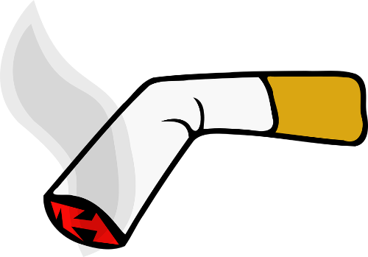
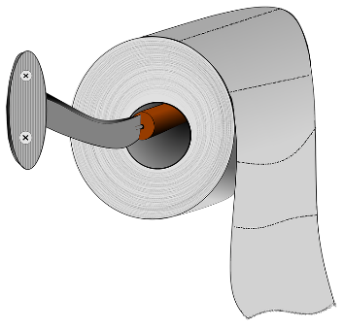
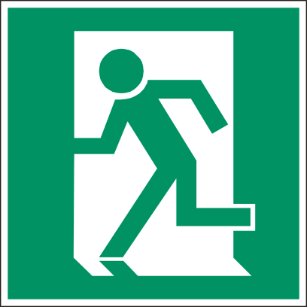
House Keeping
Fire Exits
Toilets
Smoking areas
Mobile phones
Schedule for today

Slide 3
Learning Outcomes
By the end of the session you will:
Understand the role and responsibilities of a first aider.
Be able to assess an incident.
Be able to manage an unresponsive casualty who is breathing normally.
Be able to manage an unresponsive casualty who is not breathing normally.
Be able to recognise and assist a casualty who is choking.
Be able to manage a casualty with external bleeding.
Be able to manage a casualty who is in shock.
Be able to manage a casualty with a minor injury.
Be able to manage a casualty with a fracture or dislocation.

Slide 4
Roles and Responsibilities of the First Aider
Section 1

Slide 5
Roles and Responsibilities of the First Aider
Roles of the First Aider:
Preserve Life – Administer immediate effective first aid to a casualty in order to save life.
Prevent the Condition from Worsening – Recognising and treating the cause will assist with preventing the condition from worsening.
Promote Recovery – Administer ongoing treatment and offer constant support until the arrival of qualified medical assistance.

Slide 6
Roles and Responsibilities of the First Aider
Responsibilities
The responsibilities of the first aider will be dependent on specific workplace requirements, these could include:
Ensuring the first aid equipment is fit for purpose
Arriving at the scene
Ensuring the scene is safe
Contacting the emergency services
Prioritising the treatment of casualties
Clearing up after an incident
Incident reporting and recording

Slide 7
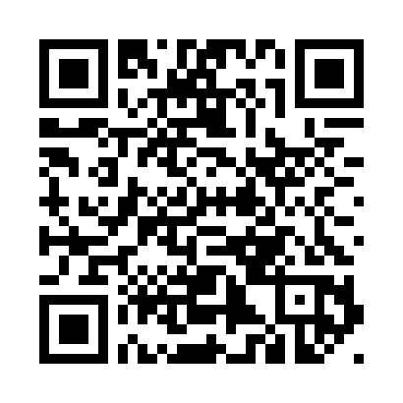
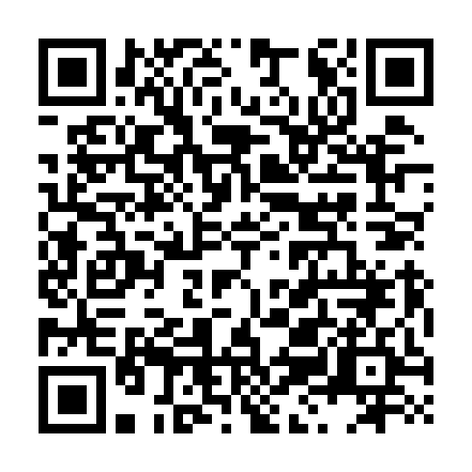
Roles and Responsibilities of the First Aider
Social Action, Responsibility and Heroism Act 2015 (SARAH)
Courts now have to take into account that defendants may have been acting to help society when an accident happened.
Designed to help first aiders, volunteers and “good deed doers” who step in heroically in dangerous circumstances but find themselves in a courtroom if something goes wrong.
legislation.gov.uk
express.co.uk

Slide 8

Roles and Responsibilities of the First Aider
Arriving at the Scene
When arriving at a scene the First Aider must:
Always try to remain calm
Take charge of the situation
Conduct a scene survey
Ensure the safety of yourself, bystanders and others
Gather information from bystanders and the casualty
Fully brief the emergency services

Slide 9
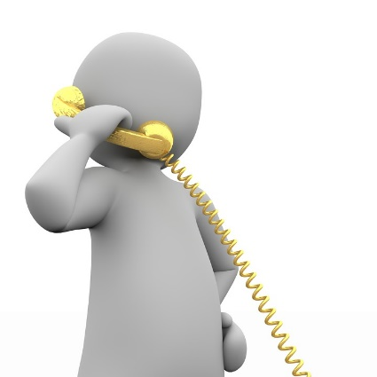
Roles and Responsibilities of the First Aider
Contacting the Emergency Services
First Aiders with ether contact the emergency services themselves or instruct a bystander to do so.
Contacting the emergency services at the earliest opportunity is paramount.
When contacting the emergency services on ether 999 or 112, it is important that the information gives is clear, concise and sufficient.

Slide 10
Roles and Responsibilities of the First Aider
Prioritising the Treatment of the Casualties
After conducting a primary survey and contacting the emergency services, casualties should be placed in an order of priority and treated accordingly. This order is as follows:
Breathing
Bleeding
Bones or Burns
Other conditions

Slide 11
Roles and Responsibilities of the First Aider
Minimising Infection
It is important that as the first aider you do not transmit infections to your casualty or indeed contract infections from your casualty.
To assist in minimising the risk of infection and cross-contamination there are various precautions that can be taken:
Having good personal hygiene
Ensuring that barrier devices are used
Covering any open cuts or sores
Minimising contact with blood or bodily fluids
Changing gloves between casualties
Washing hands thoroughly after removing gloves

Slide 12
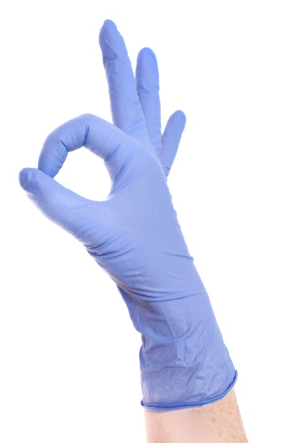
Roles and Responsibilities of the First Aider
Barrier Devices
Barrier devices are essential equipment and help to eradicate the spread of infection and cross contamination.
Barrier devices place a barrier between the first aider and the casualty.
Barrier devices include:
Nitrile powder free cloves
Face shields
Pocket masks

Slide 13
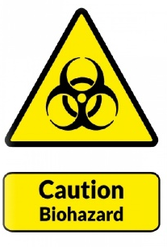
Roles and Responsibilities of the First Aider
Clearing Up After an Incident
Once an incident has been handed over to qualified medical assistance, then the clearing up process must commence.
This process consists of the following:
Ensure that all used items such as; bandages, gloves etc. are placed in a yellow clinical waste bag or something similar.
Ensure that the area where any blood or other bodily fluids have been spilt is thoroughly cleaned.
Restock the first aid kit and replace an other equipment that may have been used during the incident.
Record and report the incident.

Slide 14
Seizures
Section 2

Slide 15


Seizures
Epileptic Seizure
An epileptic seizure s caused by a sudden burst of excessive, electrical activity in the brain causing a temporary disruption to signals passing between brain cells. There are many different forms of epilepsy however to aid recognition and treatment these have been generalised into two categories:
Partial seizures
Generalised seizures
Source:
British Red Cross

Slide 16
Seizures
Partial seizure
A partial seizure is a brief loss of responsiveness for a few seconds or minutes.
Recognition
Staring blankly
Mood swings
Feeling of Déjà vu
Tingling sensations
Twitching (face and body)
Treatment
Ensure the casualty is safe from harm
See is the casualty can be laid or sat down
Stay with the casualty and time the episode
If it is the first time recommend the casualty to go to hospital or call an ambulance 999/112

Slide 17
Seizures
Generalised seizure
The most common and widely recognised generalised seizure is called a tonic-clonic (grand mal) seizure which affects the body in progressive ways. Prior to suffering a seizure, a casualty may be confused, have headaches or undergo strange tastes or smells; this is called an ‘aura’.
Recognition – Tonic phase
Convulsions
Muscles become rigid
Arching back
Cyanosis (blue or purple colouration)
Recognition – Clonic phase
The limbs make violent jerking movements
Rolling eyes and crying out
Clenched teeth
Possible loss or bladder and bowel control
Lack of consciousness

Slide 18
Seizures
Generalised seizure
Treatment
Ensure the casualties safety by removing dangerous objects which could cause injury
Remove spectacles and loosen clothing around neck if possible
Do not restrain the casualty
Record the time and duration of the seizure
If the seizure continues (depending on site policy) or there are multiple seizures, call for an ambulance 999/112
When the seizure stops clear any excessive saliva and check airway, breathing and place into the recovery position
Reassure the casualty and be conscious of their embarrassment

Slide 19
External Bleeding
&
Hypovolemic Shock
Section 3

Slide 20
External Bleeding
Types of Wounds
Laceration (tear)
A wound that can be caused by tearing the skin resulting in a jagged edge wound. This could be caused by broken bottles or cans. The severity of blood loss will be dependent on the size of the laceration.
Abrasion (graze)
A superficial wound caused by a scrape. This is caused by falling or sliding on surfaces. Blood loss from this type of wound is minimal and will tend to bleed from capillaries and therefore ooze out of the wound.

Slide 21
External Bleeding
Types of Wounds
Incision (cut)
Normally caused by a sharp object such as a knife, scissors or piece of glass. The wound will be a clean slice and depending on the severity may result in severe blood loss.
Puncture (piercing)
Caused by an object puncturing or piercing the skin such as a needle, shard of glass or nail. A puncture wound does not cause excessive bleeding as the wound closes around the foreign object. There is a high risk of infection and if severe could cause internal damage.

Slide 22
External Bleeding
Types of Wounds
Embedded (penetrating)
Caused by a knife or bullet entering the body. The object passes through the skin and causes internal damage. There could be severe internal or external blood loss with this type of wound as well as a high risk of infection
Contusion (bruise)
Normally classes as a minor injury and will heal without treatment. A contusion is formed when damaged is formed when blood vessels are damaged underneath the skin caused by a blow from a blunt object. If the cause is more severe such as a fall there could be extensive internal damage

Slide 23
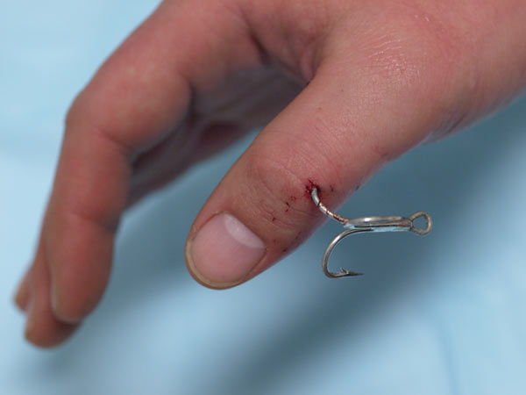
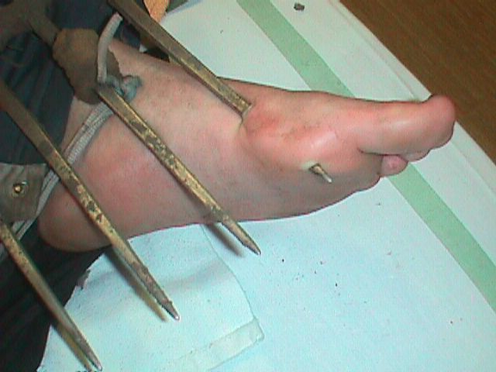
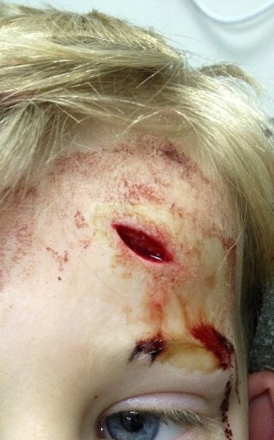
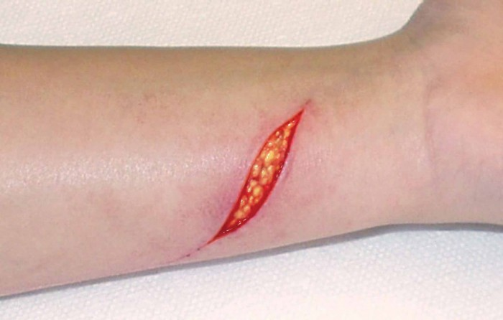
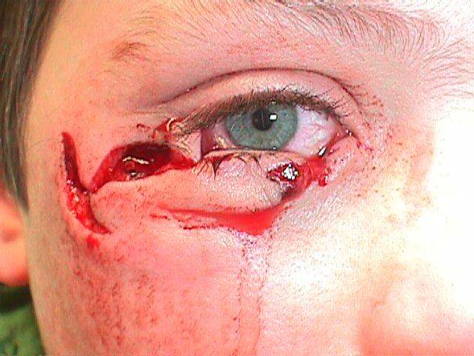
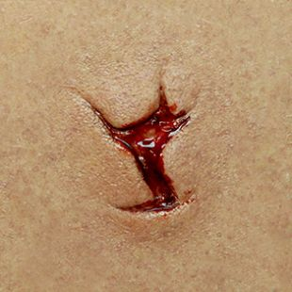
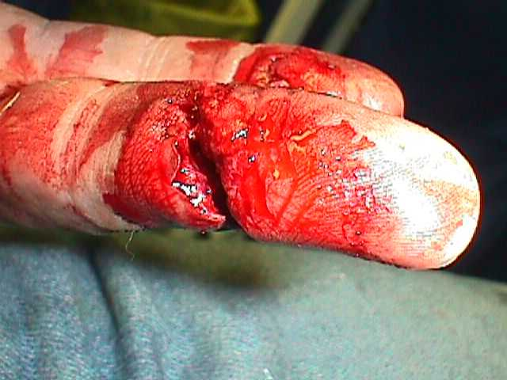
External Bleeding
Examples

Slide 24
External Bleeding
Types of Bleeding
Arterial bleeding
This is a bleed from an artery and will be bright red in colour, the blood will be under higher pressure and will pump in time with the casualties heart beat.
Venous bleeding
This bleed is from a vein and will be dark red in colour, the blood will be under lower pressure and will gush from the wound.
Capillary bleeding
This bleed is from damaged capillaries and will slowly ooze from the wound.

Slide 25
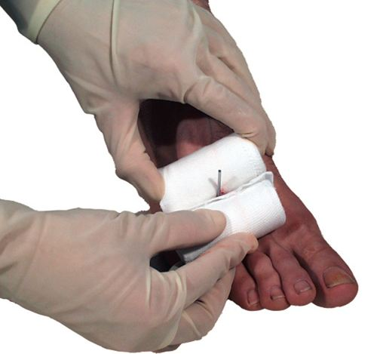
External Bleeding
Embedded Foreign Objects
Treatment
Apply dressings to ether side of the embedded object if possible to secure it in place and prevent further damage.
Apply a larger dressing over the top of the side dressings and embedded object if possible.
Secure the dressing in place e.g. elevation sling.
Call for an ambulance 999/112 and treat the casualty for shock.

Slide 26
Hypovolemic Shock
Blood Loss
Signs & Symptoms | 10% Blood loss | 20% Blood loss | 30% Blood loss | 40% Blood loss
Response level | Normal | Nausea | Lowered level of response & signs of shock | Unresponsive
Skin colour/feel | Normal | Pale/cool | Cyanosis (blue/grey appearance of nose, ears, lips), cold & clammy | Extremely pale, cold & clammy
Breathing | Normal | Slightly raised | Rapid | Gasping for breath
Pulse rate | Normal | Slightly raised | Rapid weak pulse | Undetectable

Slide 27
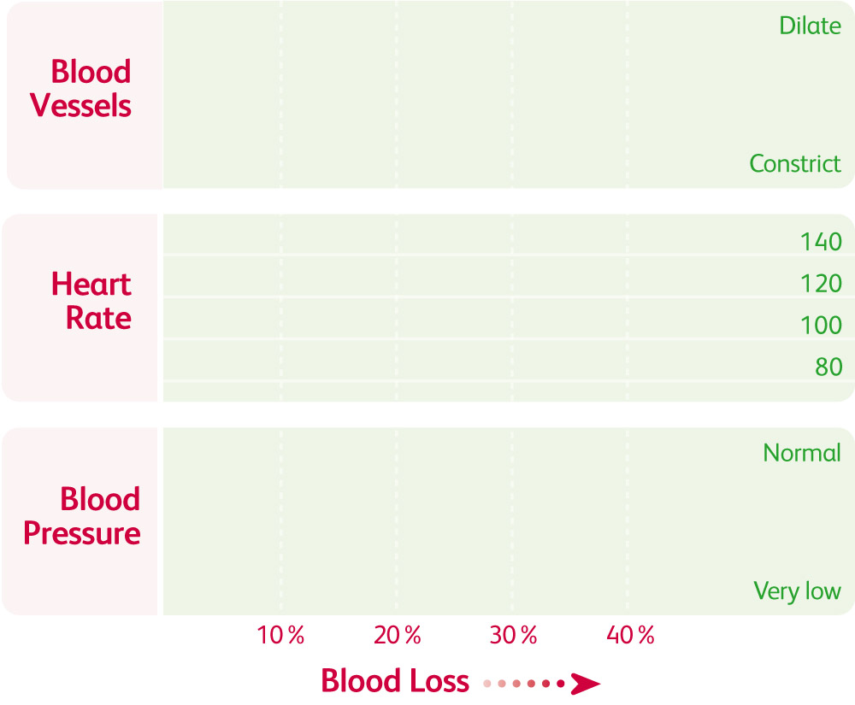
Hypovolemic Shock
Blood Loss

Slide 28
Hypovolemic Shock
Major Bleeding
Treatment
Ensure you wear personal protective equipment e.g. nitrile gloves.
Sit or lay the casualty down on the floor is possible.
Examine the wound but do not attempt to remove any foreign objects.
Apply direct pressure onto the wound and try to stop the bleeding.
Dress the wound with a sterile dressing.
If the wound bleeds through the dressing remove it completely and stop the bleeding before applying another dressing.
Call for an ambulance if necessary 999/112 and treat the casualty for shock.

Slide 29
Hypovolemic Shock
Catastrophic Bleeding
A catastrophic bleed is life threatening and must be treated accordingly to keep the casualty alive.
Following extensive use and research in combat, there is a wealth of evidence that tourniquets are effective, save lives and have a relatively low rate of complications following application.
Similarly, haemostatic dressings have also undergone significant improvements in recent years, have low complication rates and have saved many lives.

Slide 30

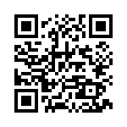
Hypovolemic Shock
Catastrophic Bleeding – CAT Tourniquet
Reference:
The First Aid Show

Slide 31
Hypovolemic Shock
Catastrophic Bleeding – Tourniquets
Dangers
Not applying tourniquet tight enough will cause blood to continue to pass through the artery but will restrict the flow back to the body by the veins.
Hesitation.
Remember to write the time on the tourniquet and tighten if bleeding still occurs.
Do not remove the tourniquet once applied.

Slide 32

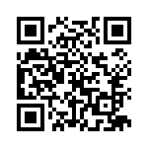
Hypovolemic Shock
Catastrophic Bleeding – Haemostatic Dressing
Reference:
The First Aid Show

Slide 33
Minor Injuries
Section 4

Slide 34
Minor Injuries
Minor Cuts and Grazes
A minor cut or graze will not bleed excessively therefore the main concern is to protect the wound from infection.
Recognition
Will not bleed excessively
Ooze blood
Sometimes very painful
Treatment
Wear appropriate personal protective equipment. (e.g. nitrile gloves)
Examine the wound for any foreign objects
Clean the effected area with a sterile cleansing wipe
Apply a sterile dressing to the wound

Slide 35
Minor Injuries
Contusion (bruises)
A bruise will often be caused by a blunt blow or a violent movement of a joint such as during a fall.
Recognition
Swelling
Blue, purple or black colouration
Probable cause associated with injury (e.g. stairs)
Treatment
Rest the area where the bruise has developed
Apply Ice
Compress the area
Elevate if possible
R I C E

Slide 36
Minor Injuries
Foreign Objects
Foreign objects can cause damage when they enter the body through wounds or orifices such as the nose or eye. You should seek medical attention unless the injury is extremely minor (e.g. surface dirt in a graze).
Ear and nose treatment
Do not attempt to remove the object
Cover with a sterile dressing
Seek medical attention (999/112) for advice

Slide 37
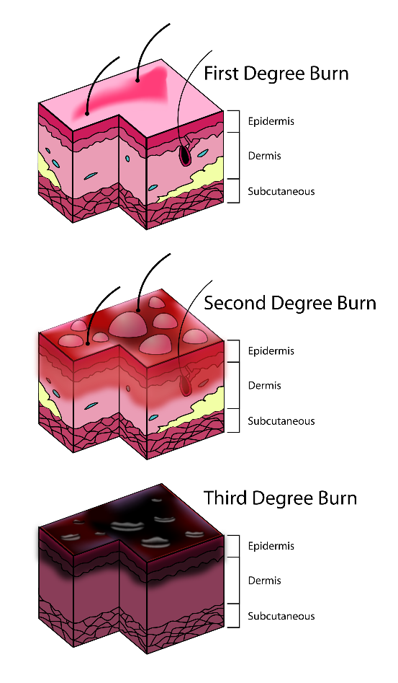
Minor Injuries
Burns and Scalds
Causes
Dry heat
Electricity
Chemicals
Extreme cold
Radiation
Burns are classified into 3 levels of severity:
Superficial burn (1st degree burn)
Partial-thickness burn (2nd degree burn)
Full-thickness burn (3rd degree burn)

Slide 38

Minor Injuries
Superficial Burn (1st Degree Burn)
A superficial burn is where the topmost layer of skin has been burnt. A superficial burn is extremely painful as the nerve endings are sensitive
Recognition
Pain at the site of the injury
Redness, swelling and tenderness
Possible blistering
Treatment
Remove the source of heat
Wear appropriate personal protective equipment (e.g. gloves)
Cool the area of the burn with water for a minimum of 10 mins
Remove restrictive clothing and jewellery if possible
Cover the burn with a layer of cling film if possible and seek medical advice (999/112) if the burn covers more than 5% of the bodies surface

Slide 39

Minor Injuries
Partial-thickness Burn (2nd Degree Burn)
A partial-thickness burn is where the epidermis and dermis have been burnt to varying degrees. There is a high risk of infection and possibility of the casualty going into shock.
Recognition
Skill will appear raw and swollen
Wound will be painful
Blisters that emit a clear fluid maybe present
Treatment
Remove the source of heat
Wear appropriate personal protective equipment (e.g. gloves)
Cool the area of the burn with water for a minimum of 10 mins
Remove restrictive clothing and jewellery if possible
Cover the burn with a layer of cling film if possible and seek medical assistance (999/112) if the burn covers more than 1% of the bodies surface

Slide 40

Minor Injuries
Full-thickness Burn (3st Degree Burn)
A full-thickness burn is where all layers of the dermis and even the subcutaneous layer have been damaged. This has an very high risk if infection and shock.
Recognition
Injury will appear brown or black and often charred
Dry and leathery texture
Limited movement around the effected area
Less pain than superficial burn as nerves have been burnt away
Treatment
Remove the source of heat
Wear appropriate personal protective equipment (e.g. gloves)
Cool the area of the burn with water for a minimum of 10 mins
Remove restrictive clothing and jewellery if possible
Cover the burn with a layer of cling film if possible and seek medical assistance immediately (999/112)

Slide 41
Minor Injuries
Sprains and Strains
A sprain or strain attributed to activity or playing sport. It is caused by a sharp movement or overstretch to a muscle or joint.
Recognition
Pain, bruising and swelling
Loss of movement
Cramps to muscle
Treatment
Rest the area where the bruise has developed
Apply Ice
Compress the area
Elevate if possible
R. I. C. E.

Slide 42
Minor Injuries
Splinters
Splinters are foreign objects which are embedded into the skin, these foreign objects such as; glass, wood, plastic or metal.
Treatment
Wear appropriate P.P.E. (nitrile gloves)
Examine the object to see if it is possible to remove
If possible draw the splinter out in the same direction as the entry route
If the splinter is removed, clean the surrounding area using antiseptic wipe and cover using a sterile dressing
If the object can not be removed, cover using a sterile dressing and advice casualty to
seek medical assistance.

Slide 43
Fractures and Dislocations
Section 5

Slide 44
Fracture and Dislocation
Fracture
A fracture is a chip, crack or break in a bone.
Recognition
Pain, swelling, tenderness and bruising around the site of the injury
Associated bleeding possible in open fractures
Loss of mobility
Nausea, pale, cold clammy skin
Treatment
Wear appropriate P.P.E. (e.g. nitrile gloves)
Treat any bleeding
Immobilise the bone in the position that it is found and most comfortable
Call for an ambulance (999/112)

Slide 45
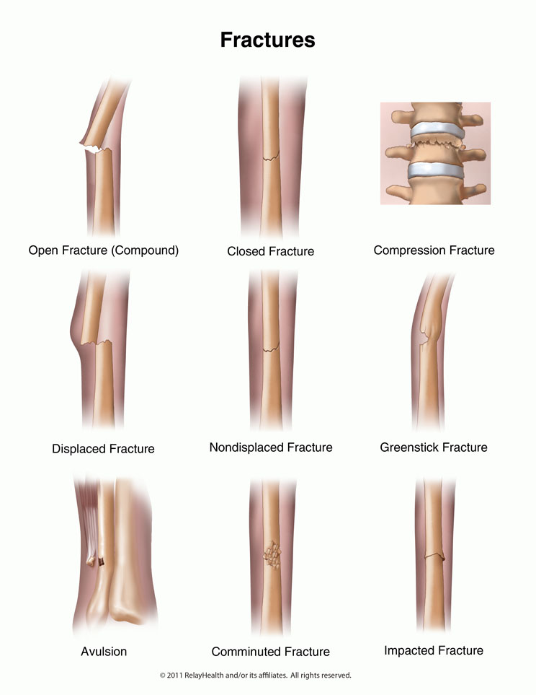
Fracture and Dislocation
Fracture
Fractures are classed into the following:
Closed – bone has fractured but has not penetrated the skin.
Open – bone has fractured and penetrated the skin, this has a high risk of infection and bleeding.
Complicated – bone has shattered or broken up internally causing further damage to tendons, blood vessels or organs if moved.
Green stick – cracking or splintering of the bone.

Slide 46
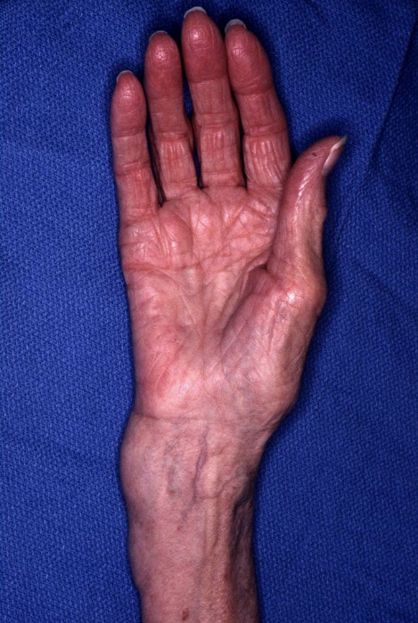
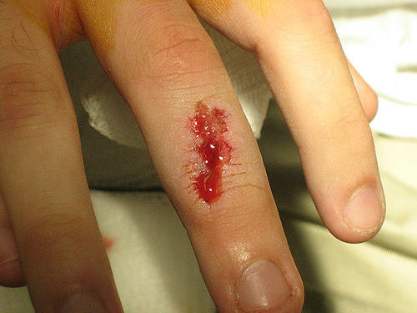
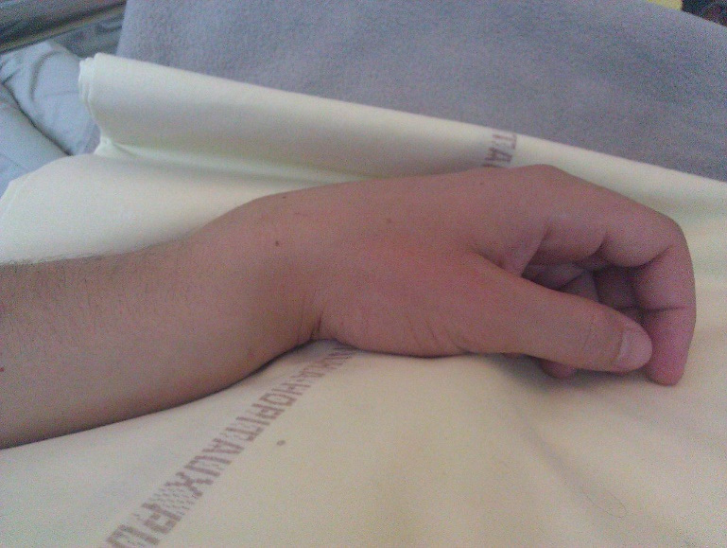
Fracture and Dislocation
Example - Fractures

Slide 47
Fracture and Dislocation
Spinal Injury
Spinal injuries are very serious as the they may cause paralysis or even death.
Recognition
Unusual position of the head or body
Pain at the site of the injury
Lack of mobility
Weakness and tingling sensations
Loss of bowl or bladder control
Signs of shock
Treatment
Call for medical assistance (999/112)
Keep the casualty in the position that you found them and immobilise the head and neck
Reassure the casualty and ask them to remain still
Keep the casualty warm
Keep monitoring the casualties airway and breathing
Be prepared to perform basic life support

Slide 48
Fracture and Dislocation
Dislocation
A dislocation occurs when a joint becomes displaced or misaligned. A dislocations are often caused by a sudden impact to the joint.
Recognition
Pain, redness and swelling
Loss of movement
Deformity
Treatment
Immobilise and support in the position found
Allow the casualty to get in a comfortable position
Call for medical assistance (999/112)
Treat for shock if necessary

Slide 49
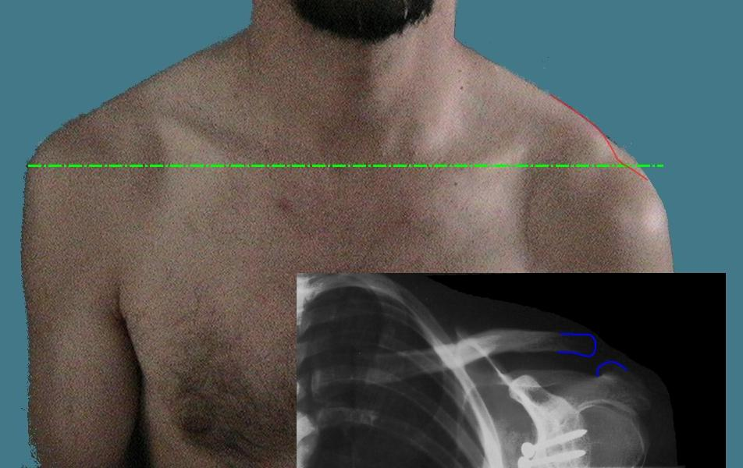
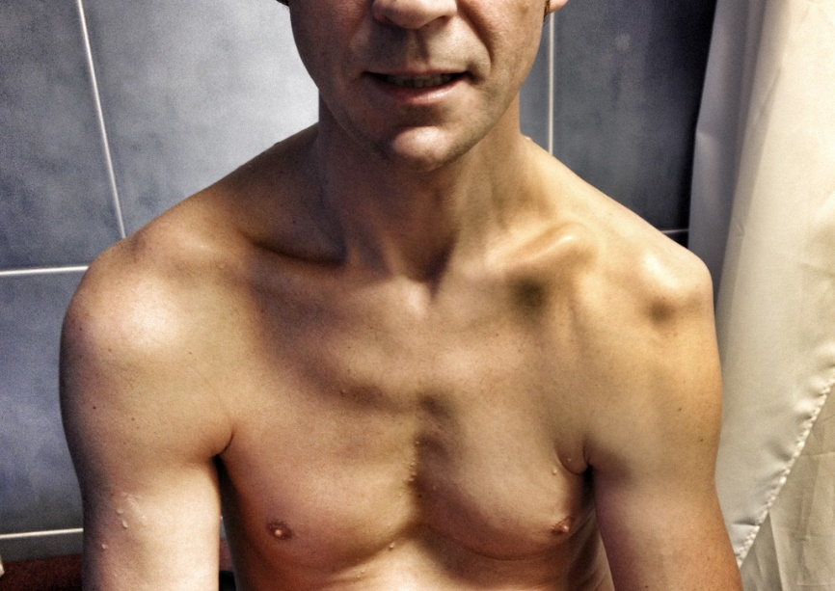
Fracture and Dislocation
Example - Dislocation

Slide 50
Comfort Break

Slide 51
Choking
Section 6

Slide 52
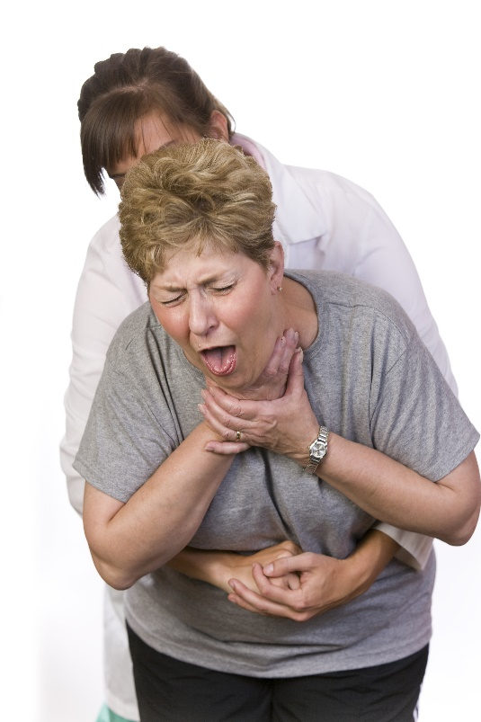
Choking
Choking casualties
A casualty will ether have a mild or severe airway obstruction. The severity of the blockage will determine how to treat the casualty.
Recognition:
Gasping for air
In distress
Difficulty breathing or speaking
Grasping the throat
Red in the face

Slide 53
Choking
Partial Blockage
A casualty with a partial blockage can be helped by:
Lean the casualty forward
Encouraging the casualty to cough
This will normally clear the partial blockage.

Slide 54
Choking
Fully Blocked Airway
If this procedure does not work then more aggressive action is necessary, follow the following procedure:
Abdominal Thrust
Stand the casualty and put both arms around the casualties abdomen just below the rib cage.
With one hand clench your fist and place it between the naval and rib cage.
Grasp this hand with your other hand and pull sharply inwards and upwards.
Repeat this up to 5 times and assess the casualties condition, if the casualties condition has not improved call 999/112 and repeat the cycles of back slaps and abdominal thrusts until qualified medical assistance arrives.

Slide 55
Choking
Choking Adult Flow Chart
Encourage the casualty to cough and lean forward.
Shout for help!
Give up to 5 back blows.
Assess the casualties condition.
Give up to 5 abdominal thrusts.
Assess the casualties condition.
Call an ambulance 999/112 and continue back blows and abdominal thrusts.

Slide 56
Comfort Break

Slide 57
Assessing an Incident and
Casualty Handling
Section 7

Slide 58
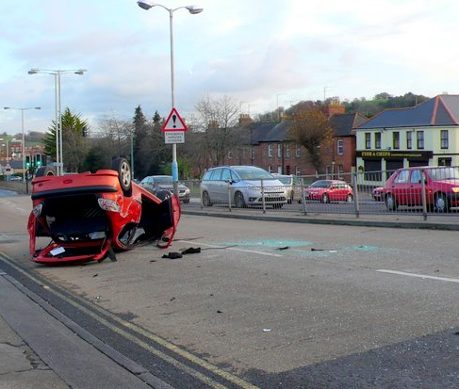
Assessing an Incident
Scene Survey
Upon arrival at an incident a scene survey must be conducted to ensure the safety of the casualty, any bystanders and the first aider.
The scene survey should be conducted in the following way:
Control the situation
Look for potential hazards
Assess the situation
Protect and prioritise

Slide 59
Assessing an Incident
Gathering Patient Information
Whilst communicating with the casualty it is important to gather as much information about them and the situation as possible, this will help you the first aider as well as the emergency services when they arrive.
The best way to gather information is to look at the casualties:
History – uncover as much information about the casualty as possible, information such as; time, location, nature of the accident, witnesses and injuries sustained. It is also important to find out if the casualty is taking any prescribed medication and a history of similar injuries or conditions.
Signs – what you as the first aider can see, smell or hear.
Symptoms – what the casualty actually feels such as any pain or feeling nauseous or weak.

Slide 60
Assessing an Incident
Gathering Patient Information
W - What happened
H - How did it happen
A - Are they wearing a medical alert bracelet?
T - The time of the accident/incident
S - Sign of injury
K - Known medication/previous injuries/allergies
E - Eating time of last meal
Y - You now need to conduct a secondary survey

Slide 61
Casualty Handling
Casualty Communication
Clear and effective communication should be used at all times when dealing with a casualty.
A casualty maybe in a distressed or confused state, the first aider should remain calm and consider the following when dealing with the casualty:
Gather as much information as possible about the situation, let the casualty explain if possible
Only speak about facts, not what your opinion is
Speak clearly and slowly without shouting and maintain eye contact
Allow the casualty time to think and respond
Ask the casualty to assist wherever possible (to distract them)

Slide 62
Casualty Handling
Primary Survey
Having conducted a scene survey and established that the immediate area is safe from dangers you may now approach the casualty.
An initial assessment should be conducted on the casualty which is called a primary survey.
The primary survey is a systematic process of approaching, identifying and dealing with immediate and/or life threatening conditions.
The primary survey can be remembered by the acronym D. R. A. B. C. D.

Slide 63
Casualty Handling
D. R. A. B. C. D.
Danger
Response
Airway
Breathing
Call 999 / Circulation
Defibrillation
Prior to approaching the casualty, ensure the safety of the casualty, yourself and any bystanders.
Check the casualty for response by asking the casualty if they are ok and tap them on their shoulder.
Place the casualty on their back. Open the airway using the head tilt and chin lift method.
Place your cheek next to the casualties mouth; look, listen and feel for normal breathing for 10 seconds.
Ask a helper to call for medical assistance.
Send someone to get an AED if available and start CPR.
If an AED arrives, switch it on and follow the prompts.
An AED is used in conjunction with CPR.

Slide 64
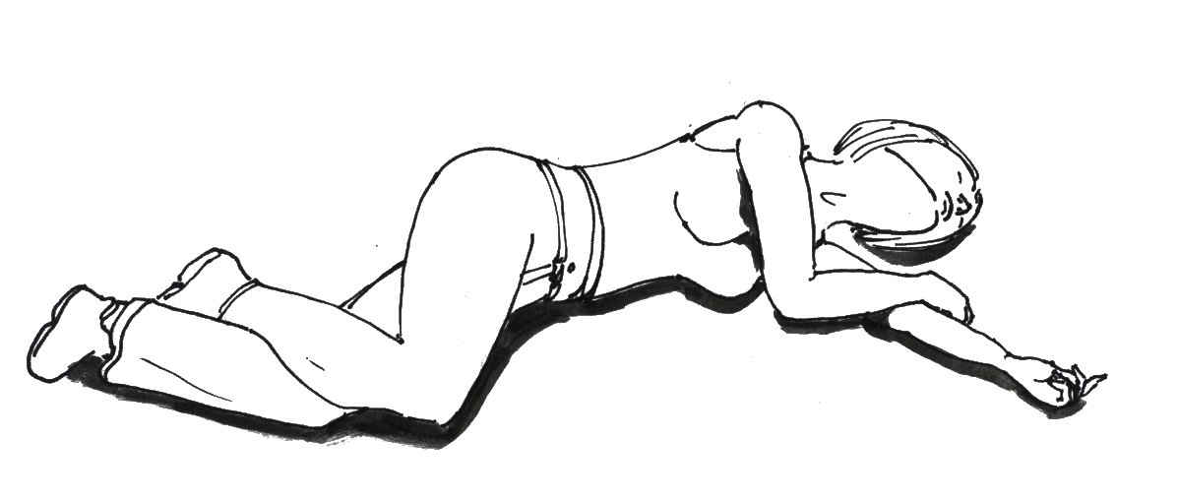
Casualty Handling
The Recovery Position
Placing a casualty in the recovery position helps to keep the tongue from falling to the back of the tongue blocking the airway and also helps fluids run out of the mouth if the casualty vomits.

Slide 65
Casualty Handling
Level of Consciousness
The Glasgow coma scale (GCS) is how medical professionals determine how conscious a casualty is. A simplified version of this is as follows:
A
V
P
U
Alert
Voice
Command
Question
Pain
When touched
When moved
Unresponsive

Slide 66
Tutor Demonstration and Learner Practice
Check for dangers
Check for response
Roll the casualty from front to back
Check the casualties airway
Check the casualty is breathing
Action as if the casualty was vomiting
Recovery position

Slide 67
Comfort Break

Slide 68
Cardio Pulmonary Resuscitation
Section 8

Slide 69
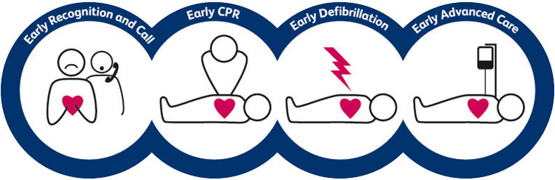
Cardio Pulmonary Resuscitation
Chain of Survival
The chance of survival of a casualty who has suffered a cardiac arrest will diminish by around 6-10% with each passing minute unless action is taken.
The chain of survival is a series of actions, that when put into motion quickly will increase the casualties odds of survival. If the chain has links broken the odds of survival will be reduced.

Slide 70
Cardio Pulmonary Resuscitation
Adult Basic Lift Support and Automated External Defibrillation
Check for danger
Check for response
Open the airway
Look, listen and feel for normal breathing for 10 seconds
Call an ambulance (999/112), send someone to get an AED
Administer CPR – start with 30 chest compressions
Give 2 effective rescue breaths
Continue with CPR 30:2

Slide 71
Cardio Pulmonary Resuscitation
Agonal Breathing
Agonal breathing is an abnormal pattern of breathing and brainstem reflex characterized by gasping, laboured breathing, accompanied by strange vocalizations.
In the first few minutes after a cardiac arrest, a casualty maybe barely breathing or taking infrequent slow noisy gasps.
Do not mistake this for normal breathing, if in any doubt act as if no breathing is present and prepare to start CPR.

Slide 72

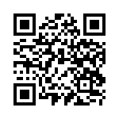
Cardio Pulmonary Resuscitation
Agonal Breathing
Source:
American Heart Association

Slide 73

Cardio Pulmonary Resuscitation
Automated External Defibrillator (AED)
The AED is used in conjunction with effective CPR and will prompt you to do actions.
The AED is completely safe to use by anyone as it does not require any training to be able to use and will not progress to the next prompt until it has detected that the step has been completed.

Slide 74
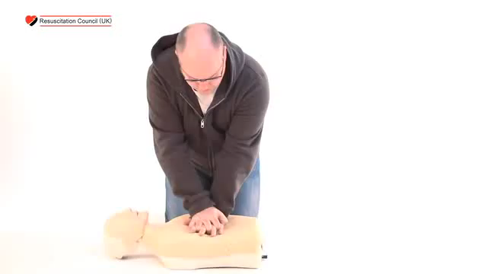
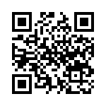
Cardio Pulmonary Resuscitation
Automated External Defibrillator (AED)
Reference:
Resuscitation Council (UK)

Slide 75
Cardio Pulmonary Resuscitation
Automated External Defibrillator (AED)
Leave the AED turned on until further medical assistance arrives as it provides a history of the casualty to the medical professionals.
Do not remove the electrode pads from the casualty or turn off the AED even if the casualty regains consciousness.
The AED will analyse the casualties heart rhythm every 2 minutes and advise a shock if necessary.

Slide 76
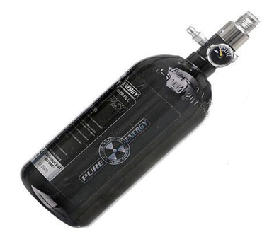
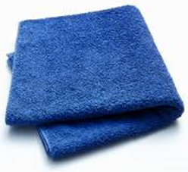
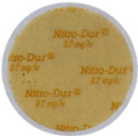
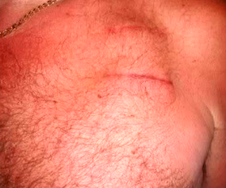
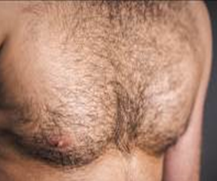
Cardio Pulmonary Resuscitation
Safety Precautions

Slide 77
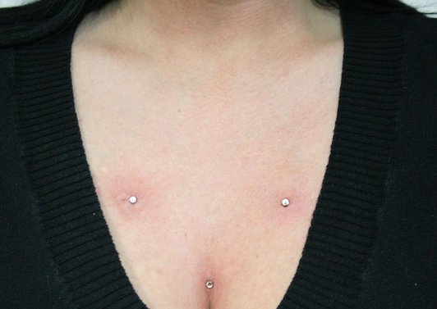
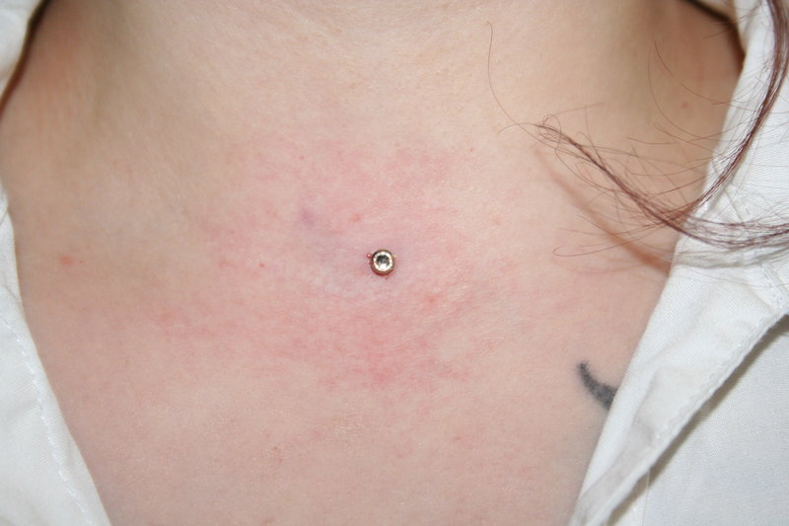
Cardio Pulmonary Resuscitation
Jewellery
The AED pads must not be placed on top of any jewellery such as necklaces and dermal piercings in the skin.
If a dermal piercing is present and cannot be removed you will need to alter the placement of the pads.

Slide 78
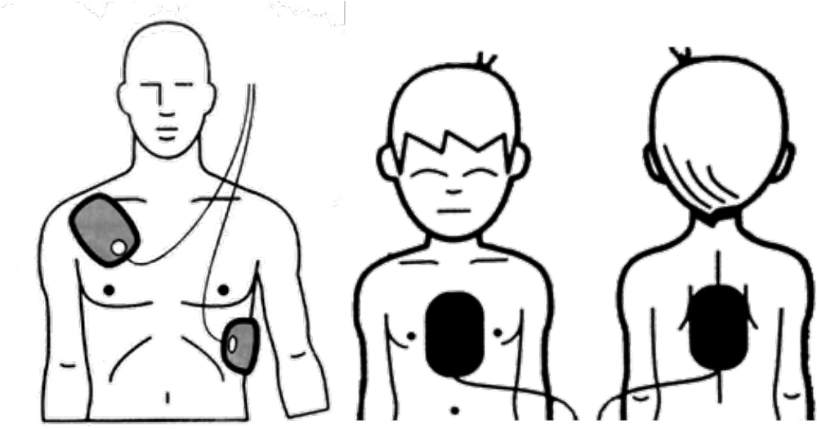
Cardio Pulmonary Resuscitation
Pad placement - Adult
On most AED’s both pads are the same, however pictures will show where to place the pads correctly.
One pad will be placed to the right of the sternum, the other will be placed below the left armpit (approx. 10cm).

Slide 79
Tutor Demonstration and Learner Practice
Check for dangers
Check for response
Check the casualty’s airway
Check the casualty is breathing
Call for assistance (999/112)
Begin CPR
When an AED arrives, place the AED onto the casualty and follow its instructions

Slide 80
Comfort Break

Slide 81
First Aid
Section 9

Slide 82
Roles and Responsibilities of the First Aider
First Aid Boxes - Standard
Contents | Leaflet | Contents list | Medium dressing | Large dressing | Triangular bandage | Safety pins | Eye pads | Plasters | Wipes | Adhesive tape | Nitrile gloves (pairs) | Finger dressing | Resus face shield | Foil blanket | Eyewash (250ml) | Burn dressing | Safety shears | Conforming bandage
Small | 1 | 1 | 4 | 1 | 2 | 6 | 2 | 40 | 20 | 1 | 6 | 2 | 1 | 1 | 0 | 1 | 1 | 1
Medium | 1 | 1 | 6 | 2 | 3 | 12 | 3 | 60 | 30 | 1 | 9 | 3 | 1 | 2 | 0 | 2 | 1 | 2
Large | 1 | 1 | 8 | 2 | 4 | 24 | 4 | 100 | 40 | 1 | 12 | 4 | 2 | 3 | 0 | 2 | 1 | 2
Travel | 1 | 1 | 1 | 1 | 1 | 2 | 0 | 10 | 4 | 1 | 1 | 0 | 1 | 1 | 1 | 1 | 1 | 1

Slide 83
Roles and Responsibilities of the First Aider
Incident Recording and Reporting
After any first aid incident it is important the incident is recorded and reported in full.
Ultimately the employer is responsible for the reporting of accidents however you should be clear on your role as the first aider in this process.
The accident book should be completed in full and populated with clear and concise information. There may also be the necessity to report the incident under ‘R. I. D. D. O. R.’.
In cases where a public access AED has been used, there may be a requirement to report the event to your local authority or ambulance service.

Slide 84
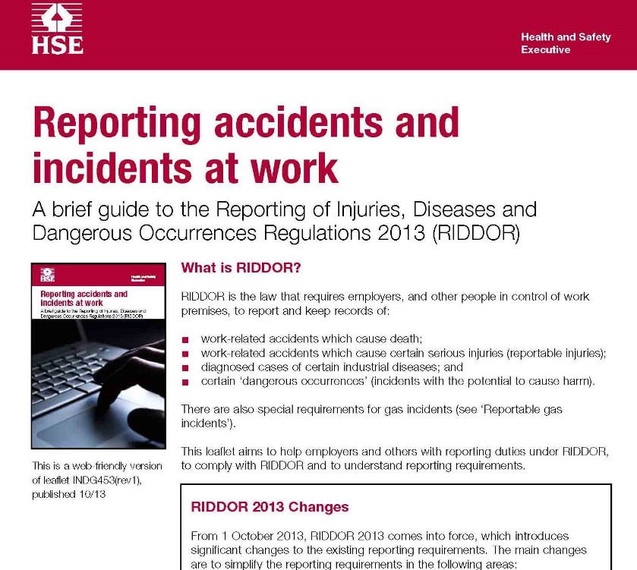
Roles and Responsibilities of the First Aider
Reporting of Injuries, Diseases and Dangerous Occurrence Regulations (R. I. D. D. O. R.)
R. I. D. D. O. R. is the law that requires employers, and other people in control of work premises, to report and keep records of:
Work-related accidents which cause death.
Work-related accidents which cause certain serious injuries (reportable injuries).
Diagnosed cases of certain industrial diseases.
Certain ‘dangerous occurrences’ (incidents with the potential to cause harm).

Slide 85
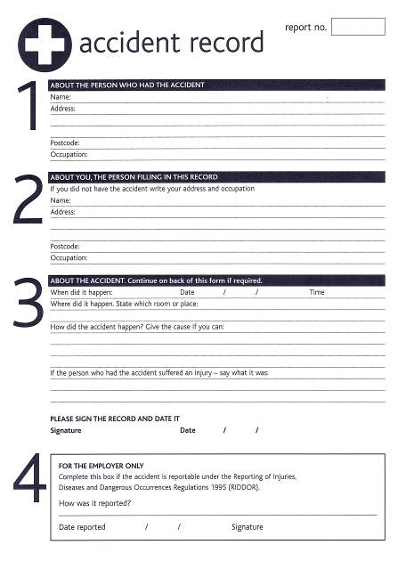
Roles and Responsibilities of the First Aider
Accident Form
The accident form should be filled out with as much detail as possible relating to the incident, including:
Who was involved
Specific details of the incident and injury
Witnesses present

Slide 86
Tutor Demonstration and Learner Practice
Apply pressure and elevate the wound.
Once bleeding has stopped, clean the wound.
Apply a dressing to the wound.
Place the wound in an elevation sling when appropriate.
Fill out an accident report form (found in learner pack).

Slide 87
Summative Assessment

Slide 88
Thank you
Please complete the feedback form located in your learner pack, then leave face down as directed.

