Slide 1
First Aid at Work
(Level 3)
Day 3
Course tutor: _______________________

Slide 2

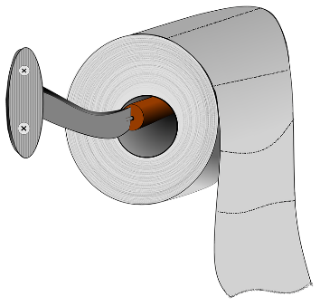

House Keeping
Fire Exits
Toilets
Smoking areas
Mobile phones
Schedule for today

Slide 3
Learning Outcomes
By the end of the session you will:
Be able to provide first aid to a casualty with heat or cold injuries.
Be able to provide first aid to a casualty with abdominal or crush injuries.
Be able to assess an incident.
Be able to conduct a primary and secondary survey.
Be able to manage an unresponsive casualty.
Recap learning outcomes of day 1 and day 2.

Slide 4
Recap topics

Slide 5
Hypothermia
Section 1

Slide 6
Hypothermia
Hypothermia
When the body is exposed to prolonged cold caused by weather, water etc. the bodies core temperature will drop. If the bodies core temperature drops below 35°C then the onset of hypothermia will occur.
Recognition
Pale, cold skin
Shivering at onset then the muscles will stiffen as the condition gets worse
Lethargic
Breathing, speech and pulse slowing
Disorientation and confusion
Diminishing level of response leading to unconsciousness and death
Treatment
Remove the casualty from the source of the cold
Cover the casualty with blankets or ensure the room is warm (approx. 25°C)
If the casualty is outdoors insulate the casualty from the ground
Give warm drinks
Monitor their condition
Call for medical assistance (999/112) if there is no improvement or is elderly or young

Slide 7
Frostbite
Section 2

Slide 8
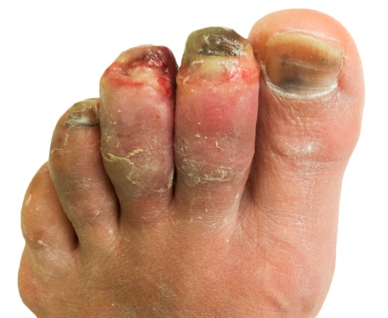
Frostbite
Frostbite
Frostbite is a serious medical condition which normally affects the extremities (fingers and toes) by causing damage to the skin due to freezing, this will eventually cause the skin to die.
Recognition
Prolonged exposure to extremely cold conditions
Pins and needles in the first stages of frostbite
Hardening and stiffening of the skin becoming painful
Skin will become purple/black and extremely painful in the later stages of frostbite
Treatment
Remove the casualty from the source of the cold
Use body heat to warm extremities (e.g. hands under arm pits)
Cover the body and extremities with blankets
Call for an ambulance immediately (999/112)

Slide 9
Heat Exhaustion
Section 3

Slide 10
Heat Exhaustion
Heat Exhaustion
Heat exhaustion is caused by the bodies core temperature rising above 37°C. In attempt to cool down, excessive sweating occurs causing the body to loose vital fluids and salts.
Recognition
Hot flushed skin
Excessive sweating
Fatigue
Headache, nausea and vomiting
Rapid pulse
Confusion
Urinating less (urine dark in colour)
Treatment
Move the casualty to a cool place
Give the casualty a sports energy drink or water to rehydrate
Remove any excessive clothing
Monitor the casualty’s response levels
Call for medical assistance (999/112)

Slide 11
Heatstroke
Section 4

Slide 12
Heatstroke
Heatstroke
Heatstroke is when the hypothalamus (the bodies temperature regulator) ceases working and the body can not cool down through normal actions such as sweating. The core temperature rises above 40°C which is very dangerous.
Recognition
High temperature and dry skin
Nausea, dizziness and vomiting
Intense headache
Lower response levels
Rapid pulse and breathing
Muscle cramps
Possibly unconscious
Treatment
Move the casualty to a cool place
Call for medical assistance immediately (999/112)
Give the casualty a sports energy drink or water to rehydrate
Try to cool the skin by applying a damp towel or spraying with water
Be prepared to carry out basic life support

Slide 13
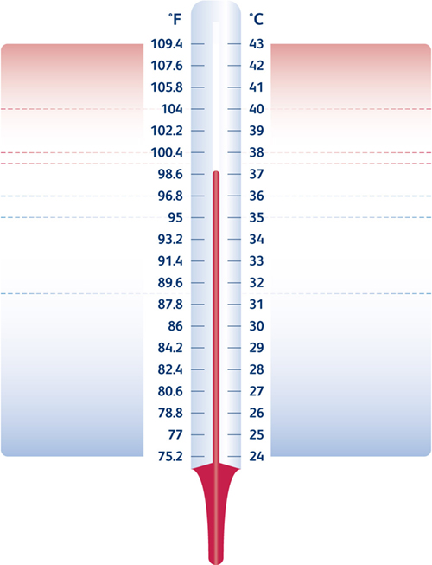
Unconsciousness / fitting
Confused / restless
Heat Stroke
Headache, dizzy, uncomfortable
Strong bounding pulse
Flushed dry skin, hot to touch
Cramps in stomach / arms / legs
Heat Exhaustion
Pale sweaty skin
Nausea / loss of appetite
Normal Body Temperature
Shivering
Fatigue, slurred speech
Confusion, forgetfulness
Mild Hypothermia
Shivering stops, muscle rigidity
Very slow, very weak pulse
Noticeable drowsiness
Severe reduction in response levels
Unconsciousness
Dilated pupils
Pulse undetectable
Severe Hypothermia
Appearance of death
Death

Slide 14
Abdominal Injuries
Section 5

Slide 15
Abdominal Injuries
Blunt Abdominal Trauma
Common in motor vehicle accidents due to seat belts and can also be caused by punches etc. There is a concern that internal organs maybe damaged from the injury.
Recognition
Abdominal pain
Bruising and swelling
Abrasions
Nausea and vomiting
Possible blood in the urine
Signs of shock
Treatment
Call for an ambulance immediately (999/112)
Wear appropriate P.P.E. (e.g. nitrile gloves)
Gather as much information as possible
Monitor the airway and breathing
Try and lay the casualty down with their knees raised, if it is not possible let the casualty sit in a comfortable position
Treat for shock and be prepared to carry out basic life support

Slide 16
Abdominal Injuries
Penetrating Abdominal Trauma
A penetrating abdominal trauma occurs when a foreign object pierces the skin and enters the abdomen. This can cause severe damage to internal organs and blood vessels.
Recognition
Visible associated wound
Abdominal pain
Nausea and vomiting
Distressed state
Possible blood in urine
Signs of shock
Treatment
Call for an ambulance immediately (999/112)
Wear appropriate P.P.E. (e.g. nitrile gloves)
Gather as much information as possible
Monitor the airway and breathing
Try and lay the casualty down with their knees raised, if it is not possible let the casualty sit in a comfortable position
Treat for shock and be prepared to carry out basic life support

Slide 17
Crush Injuries
Section 6

Slide 18
Crush Injuries
Crush Injuries
A crush injury can cause muscle swelling and internal damage to organs and may stop blood circulating freely around the body. There is two main types of crush injuries:
Compartment Syndrome
This is the compression of nerves, blood vessels and muscles inside a compartment within the body. This can cause tissues to die from lack of blood reaching them due to the compression of the blood vessels.
Crush Syndrome (Bywater’s Syndrome)
This occurs when pressure on the muscles is released. It causes toxins to be released into the bloodstream. These toxins are highly dangerous to the kidneys and can cause renal failure and death.

Slide 19
Crush Injuries
Crush Injuries
Recognition
Loss of sensation in the affected area
Pale skin
General weakness in the area of the crush
Severe pain
Treatment
Ensure that the area is safe to approach
Establish how long the casualty has been crushed for.
  If longer than 15 minutes leave them in the position found
  If less than 15 minutes attempt to release the crush
Treat associated wounds and bleeding
Treat for shock
Call and ambulance (999/112) and request additional emergency services if required
Be prepared to carry out basic life support

Slide 20
Comfort Break

Slide 21
Casualty Handling and Secondary Survey - Recap
Section 7

Slide 22
Tutor Demonstration and Learner Practice
Check for dangers
Check for response
Roll the casualty from front to back
Check the casualties airway
Check the casualty is breathing
Conduct a secondary survey
Action as if the casualty was vomiting
Recovery position

Slide 23
Cardio Pulmonary Resuscitation
- Recap
Section 8

Slide 24
Cardio Pulmonary Resuscitation
Adult Basic Lift Support and Automated External Defibrillation
Check for danger
Check for response
Open the airway
Look, listen and feel for normal breathing for 10 seconds
Call an ambulance (999/112), send someone to get an AED
Administer CPR – start with 30 chest compressions
Give 2 effective rescue breaths
Continue with CPR 30:2

Slide 25
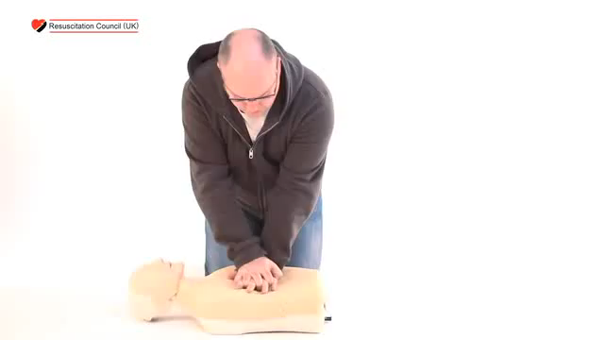

Cardio Pulmonary Resuscitation
Automated External Defibrillator (AED)
Reference:
Resuscitation Council (UK)

Slide 26
Tutor Demonstration and Learner Practice
Check for dangers
Check for response
Check the casualty’s airway
Check the casualty is breathing
Call for assistance (999/112)
Begin CPR
When an AED arrives, place the AED onto the casualty and follow its instructions

Slide 27
Comfort Break

Slide 28
Summative Assessment

Slide 29
Thank you
Please complete your individual learning plan and evaluation form located in your learner pack.
Please retain your learner pack for your reference and only return the evaluation form to your tutor.

