Slide 1
Paediatric First Aid
(Level 3)
Course tutor: _______________________

Slide 2

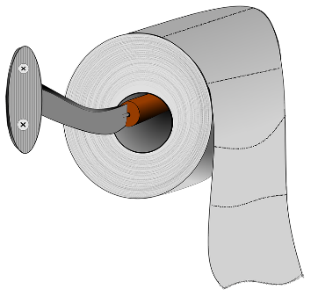
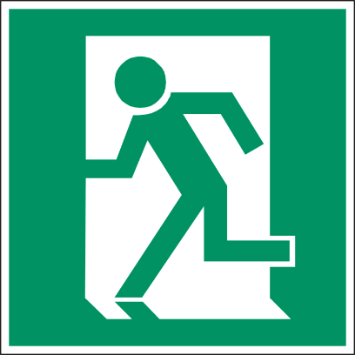
House Keeping
Fire Exits
Toilets
Smoking areas
Mobile phones
Schedule for today

Slide 3
Learning Outcomes
By the end of the session you will be able to:
administer first aid to an infant and a child with injuries to bones, joints and muscles.
administer first aid to an infant and a child with head and spinal injuries.
administer first aid to an infant and a child with conditions affecting the eyes, ears and nose.
administer emergency first aid to an infant and a child with a chronic medical condition or sudden illness.
administer first aid to an infant and a child who is experiencing the effects of extreme heat or cold.
administer first aid to an infant and a child who has sustained an electric shock.
administer first aid to an infant and a child with burns or scalds.
administer first aid to an infant and a child who has been poisoned.
administer first aid to an infant and a child who has been bitten or stung.
administer first aid to an infant and a child with minor injuries.
complete records relating to illnesses, injuries and emergencies.

Slide 4
Fractures and Dislocations
Section 1

Slide 5
Fractures and Dislocations
Fracture
A fracture is a chip, crack or break in a bone.
Recognition
Pain, swelling, tenderness and bruising around the site of the injury
Associated bleeding possible in open fractures
Loss of mobility
Nausea, pale, cold clammy skin
Treatment
Wear appropriate P.P.E. (e.g. nitrile gloves)
Treat any bleeding
Immobilise the bone in the position that it is found and most comfortable
Call for an ambulance (999/112)

Slide 6
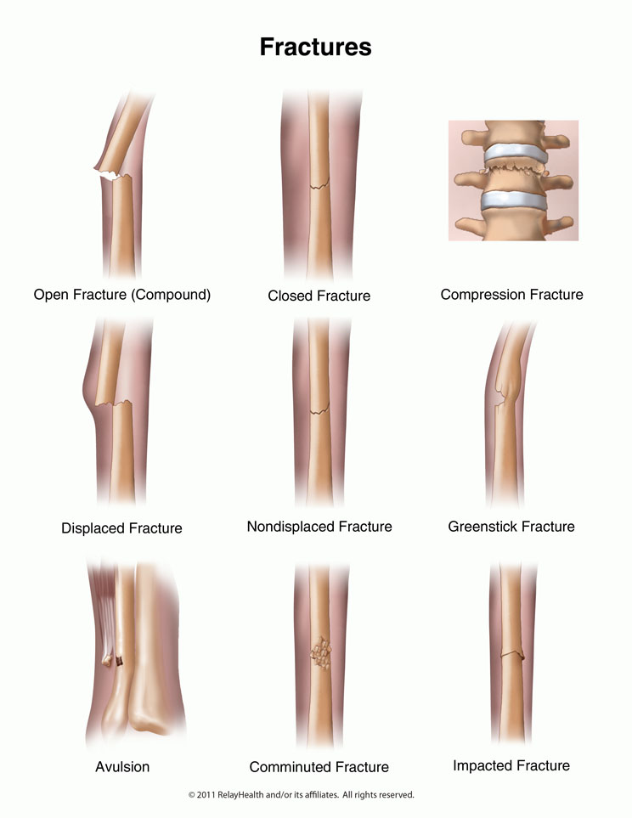
Fractures and Dislocations
Fracture
Fractures are classed into the following:
Closed – bone has fractured but has not penetrated the skin.
Open – bone has fractured and penetrated the skin, this has a high risk of infection and bleeding.
Complicated – bone has shattered or broken up internally causing further damage to tendons, blood vessels or organs if moved.
Green stick – cracking or splintering of the bone.

Slide 7
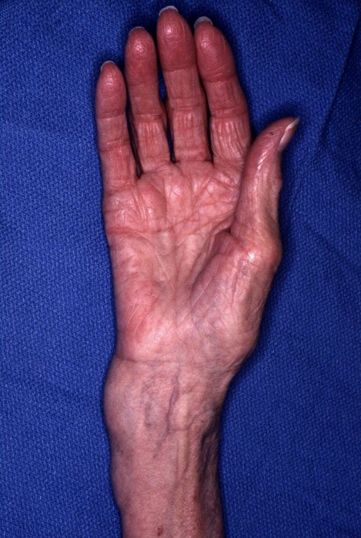
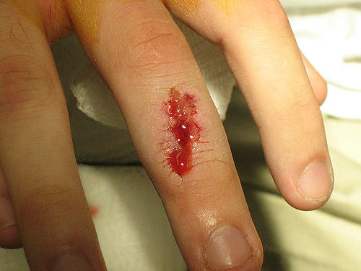
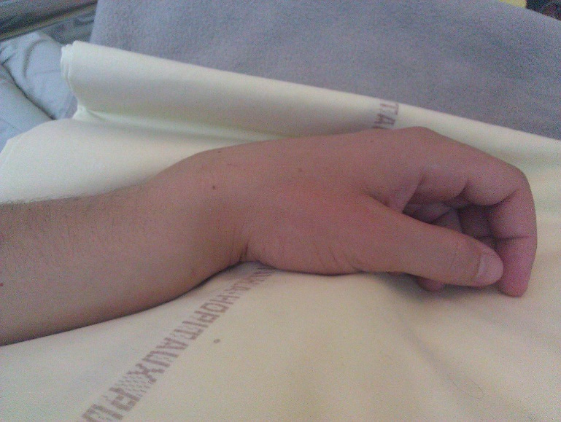
Fractures and Dislocations
Example of Fractures

Slide 8
Fractures and Dislocations
Dislocation
A dislocation occurs when a joint becomes displaced or misaligned. A dislocations are often caused by a sudden impact to the joint.
Recognition
Pain, redness and swelling
Loss of movement
Deformity
Treatment
Immobilise and support in the position found
Allow the casualty to get in a comfortable position
Call for medical assistance (999/112)
Treat for shock if necessary

Slide 9
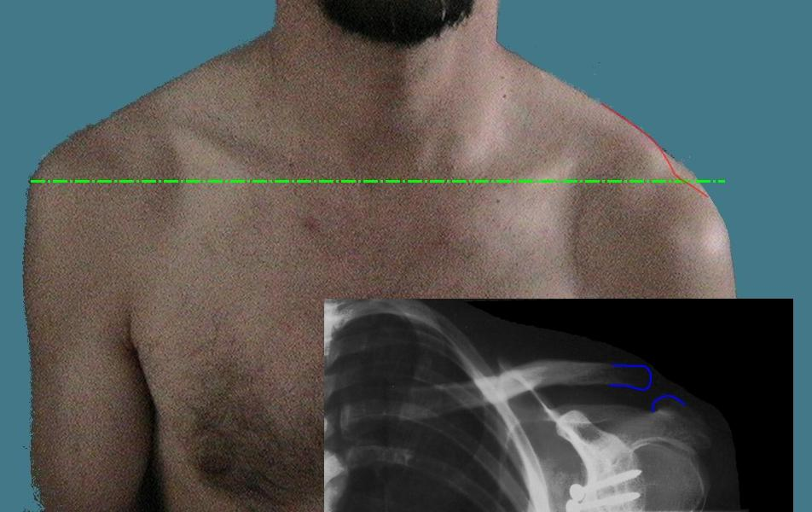
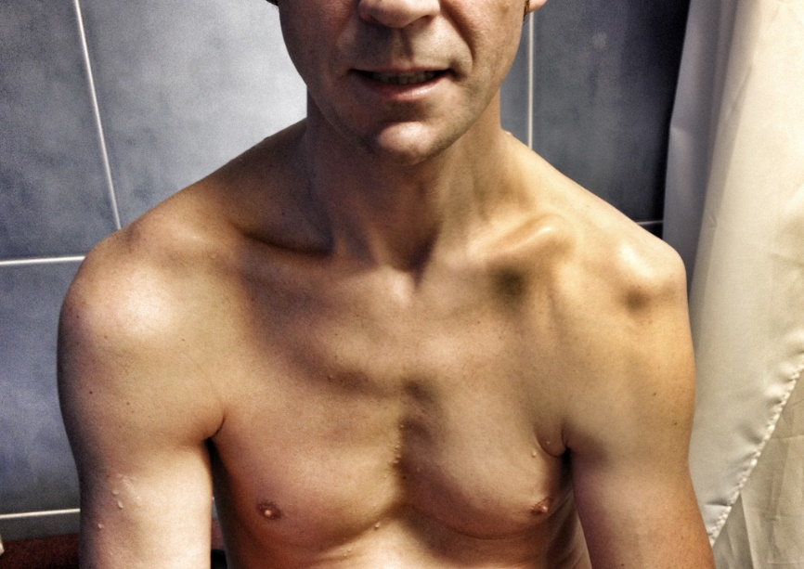
Fractures and Dislocations
Example of Dislocations

Slide 10
Sprains and Strains
Section 2

Slide 11
Minor Injuries
Sprains and Strains
A sprain or strain attributed to activity or playing sport. It is caused by a sharp movement or overstretch to a muscle or joint.
Recognition
Pain, bruising and swelling
Loss of movement
Cramps to muscle
Treatment
Rest the area where the bruise has developed
Apply Ice
Compress the area
Elevate if possible
Think.. R. I. C. E.

Slide 12
Head Injuries
Section 3

Slide 13
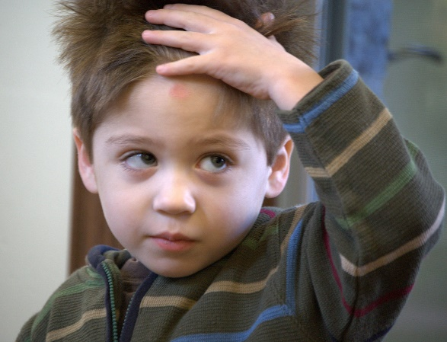
Head Injuries
Head Injury
Head injuries have the potential to be life threatening and therefore casualties should always be examined by qualified medical personnel.
Head injuries are classes into the following:
Concussion
Compression
Fractured skull
Stroke

Slide 14
Head Injuries
Concussion
Concussion is the shaking of the brain caused by a blow to the head which causes a temporary disturbance of normal brain activity.
Recognition
Possible loss of consciousness
Dizziness and nausea
Headache
Brief loss of memory
Blurred vision
Treatment
Treat any bleeding
Call for medical assistance (999/112)
Lay the casualty down on a flat surface and raise the head and shoulders
Monitor the casualty and be prepared to carry out basic life support

Slide 15
Head Injuries
Compression
Compression is a build up of pressure on the brain caused by accumulation of blood or swelling.
Recognition
Intense headache
Drowsiness
Unequal pupil sizes
Slow, strong pulse
Weakness or paralysis down one side of the body
Noisy breathing
Treatment
Treat any bleeding
Call for medical assistance (999/112)
Lay the casualty down on a flat surface and raise the head and shoulders
Monitor the casualty and be prepared to carry out basic life support

Slide 16

Head Injuries
Fractured Skull
Can ether be open or closed; caused by a blow to the head.
Recognition
Associated wound
Tenderness and pain
Depression or deformity of the skull
Bruising and swelling at the site of the injury
Presence of cerebral spinal fluid from ears and nose
Treatment
Treat any bleeding
Call for medical assistance (999/112)
Lay the casualty down on a flat surface and raise the head and shoulders
Monitor the casualty and be prepared to carry out basic life support

Slide 17
Head Injuries
Stroke
A stroke is ether short term or permanent damage to the brain and body. If you suspect a stroke you must act FAST.
Recognition
FACE – has the face dropped on one side
ARM – can the person raise both arms?
SPEECH – can the person speak clearly and understand what you say?
TIME to call 999/112 – early treatment can help prevent further damage
Treatment
Call for an ambulance immediately (999/112)
Lay casualty down with head and shoulders raised
If unconscious place in recovery position
Loosen any restrictive clothing
Monitor airway and breathing and be prepared to perform basic life support

Slide 18
Comfort Break

Slide 19
Spinal Injuries
Section 4

Slide 20
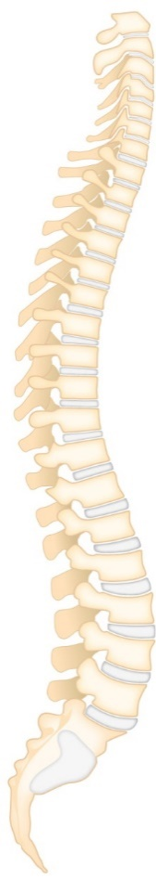
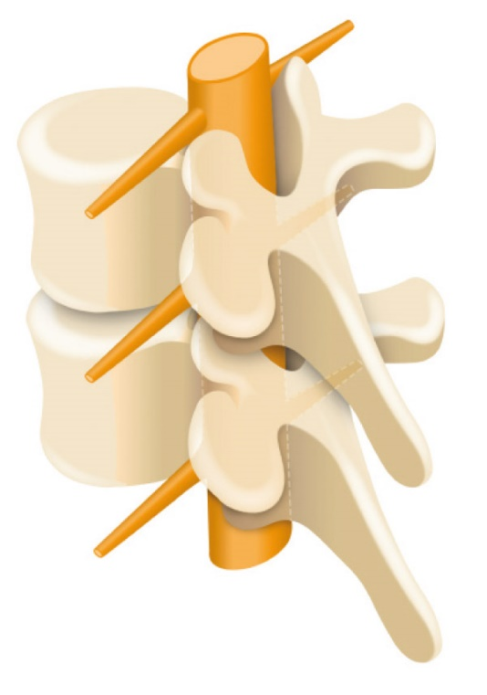
Fractures and Dislocations
Spinal Injury
Spinal injuries are very serious as the they may cause paralysis or even death.
7 Cervical
12 Thoracic
5 Lumbar
5 Fused Sacral

Slide 21
Fractures and Dislocations
Spinal Injury
Spinal injuries are very serious as the they may cause paralysis or even death.
Recognition
Unusual position of the head or body
Pain at the site of the injury
Lack of mobility
Weakness and tingling sensations
Loss of bowl or bladder control
Signs of shock
Treatment
Call for medical assistance (999/112)
Keep the casualty in the position that you found them and immobilise the head and neck
Reassure the casualty and ask them to remain still
Keep the casualty warm
Keep monitoring the casualties airway and breathing
Be prepared to perform basic life support

Slide 22
Eyes, Ears and Nose
Section 5

Slide 23

Eyes, Ears and Nose
Foreign Object - Eye
May cause damage to the eye by scratching the surface or puncturing the eye or surrounding skin
Treatment
Wear appropriate PPE (nitrile gloves etc.)
Stop the child or infant from rubbing the eye
Ask the child to open the eye wide, pull the top lid up and the bottom lid down
Inspect the eye and see if you can spot the foreign object
Ask the child to look in all directions as this movement will produce tears which may flush out the object
Use eyewash to remove the foreign object
Cover the eye with a dry sterile dressing
Infants will require immediate medical assistance

Slide 24

Eyes, Ears and Nose
Foreign Object - Ear
May cause infection and/or perforation of the eardrum.
Treatment
Make no attempt to remove the object
Cover the ear with a dry sterile dressing
Seek qualified medical assistance

Slide 25

Eyes, Ears and Nose
Foreign Object - Nose
May cause infection and difficulty in breathing. Could cause nosebleeds due to vessel damage.
Treatment
Sit the child down and ask them to lean forward (Infants will require you to move them into position)
Treat for nosebleed if necessary
Seek qualified medical attention

Slide 26
Sickle Cell Crisis
Section 6

Slide 27
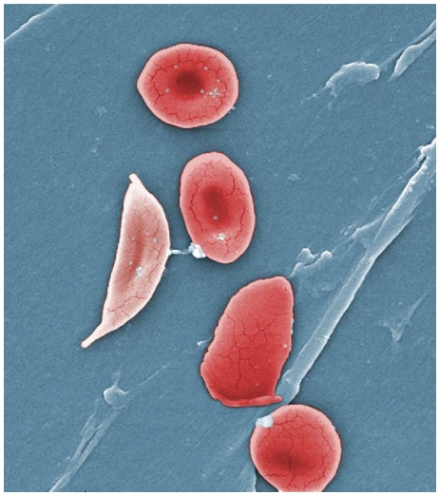
Sickle Cell Crisis
Sickle Cell Disease
Sickle cell disease mainly affects people of African, Caribbean, Middle Eastern, Eastern Mediterranean and Asian origin. In the UK, it's particularly common in people with an African or Caribbean family background.
People with sickle cell disease produce unusually shaped red blood cells that can cause problems because they don't live as long as healthy blood cells and they can become stuck in blood vessels.
Sickle cell disease is a serious and lifelong condition, although long-term treatment can help manage many of the problems associated with it.

Slide 28


Sickle Cell Crisis
Sickle Cell Disease
Recognition
Painful episodes called sickle cell crises, which can be very severe and can last up to a week
Anaemia (where red blood cells can't carry enough oxygen around the body), which can cause tiredness and shortness of breath
Reference:
NHS

Slide 29
Diabetic Emergencies
Section 7

Slide 30
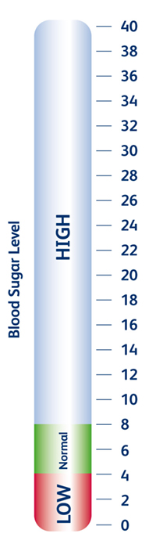
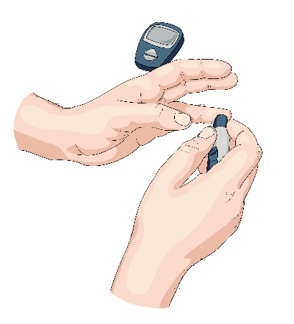

Diabetic Emergencies
Diabetes
Diabetes is caused by a failures of the bodies ability to produce insulin which regulates the blood sugar levels.
Insulin
Sugar

Slide 31
Diabetic Emergencies
Hypoglycaemia
This is caused when the blood sugar level is too low.
Recognition
Blurred vision
Hunger
Tired, confused and feeling faint
Increased heart rate
Headache
Tingling sensations
Noticeable change in personality
Treatment
Sit the casualty down, calm and reassure
Ask the casualty to take a 15 – 20g glucose tablet, sugar or sugary drink
If there is no improvement in the casualties condition call for an ambulance (999/112)
Monitor the casualties condition, if the casualty becomes unconscious be prepared to carry out basic life support

Slide 32
Diabetic Emergencies
Hyperglycaemia
This is caused when the blood sugar level is too high.
Recognition
Sweet fruity smelling breath
Increased need to urinate
Increased thirst
Dry mouth
Loss of appetite
Tiredness and confused
Treatment
Sit the casualty down, calm and reassure
Encourage the casualty to use their medication
If they have not been previously been diagnosed with diabetes then call form medical assistance (999/112)
Monitor the casualties condition, if the casualty becomes unconscious be prepared to carry out basic life support

Slide 33
Allergic Reactions
Section 8

Slide 34

Allergic Reactions
An allergy is a reaction the body has to a particular food or substance.
Allergies are very common. They're thought to affect more than 1 in 4 people in the UK at some point in their lives.
They're particularly common in children. Some allergies go away as a child gets older, although many are lifelong.
Adults can develop allergies to things they weren't previously allergic to.
Having an allergy can be a nuisance and affect your everyday activities, but most allergic reactions are mild and can be largely kept under control.
Severe reactions can occasionally occur, but these are uncommon.

Slide 35
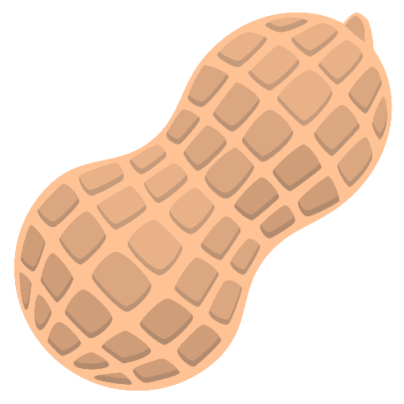
Allergic Reactions
Common allergies
grass and tree pollen
dust mites
animal dander (tiny flakes of skin or hair)
food – particularly nuts, fruit, shellfish, eggs and cows' milk
insect bites and stings
medication – including ibuprofen, aspirin and certain antibiotics
Latex
Mould
household chemicals

Slide 36

Allergic Reactions
Symptoms of an allergic reaction
sneezing
a runny or blocked nose
red, itchy, watery eyes
wheezing and coughing
a red, itchy rash
worsening of asthma or eczema symptoms
Most allergic reactions are mild, but occasionally a severe reaction called anaphylaxis or anaphylactic shock can occur. This is a medical emergency and needs urgent treatment.

Slide 37
Asthma
Section 9

Slide 38
Asthma
Asthma
Asthma is a condition that affects the airway by inflaming it making it difficult to breathe. There are many triggers of asthma which include; dust, pollen and pet hair.
Recognition
Breathlessness
Wheezing
Tightness around the chest
Bouts of coughing
Cyanosis (blue lips, ears and nose)
May be unconscious
Treatment
Sit the casualty down on a chair or floor away from the cause of the attack and let them get in a comfortable position
Encourage the casualty to take their medication (inhaler)
Calm and reassure the casualty
If the attack is prolonged call for medical assistance (999/112)
Be prepared to carry out basic life support

Slide 39



Asthma
Asthma
Salbutamol inhalers (blue) can now be kept in educational establishments first aid boxes, provided they follow the guidance.
Reference:
NHS Nottingham City Clinical Commissioning Group

Slide 40
Asthma
Hyperventilation (HVS)
Hyperventilation syndrome (HVS) is a name given to a collection of physical and emotional symptoms, largely brought about by hyperventilation. This happens when we over-breathe.
Recognition
Breathlessness / fast breathing
Tightness around the chest
Tingling (e.g. in fingers, arms, mouth)
Muscle stiffness
Trembling in hands
Dizziness, blurred vision, faintness
Headaches
Treatment
Sit the casualty down on a chair or floor and let them get in a comfortable position
Calm and reassure the casualty
Encourage the casualty to slow their breathing
If the attack is prolonged call for medical assistance (999/112)

Slide 41
Meningitis
Section 10

Slide 42


Meningitis
Description
Meningitis is an infection of the protective membranes that surround the brain and spinal cord (meninges). It can affect anyone, but is most common in babies, young children, teenagers and young adults and can be very serious if not treated quickly. It can cause life-threatening blood poisoning (septicaemia) and result in permanent damage to the brain or nerves.
Reference:
Public Health England & NHS

Slide 43
Meningitis
Meningitis
Recognition
High temperature (fever) over 37.5C
Nausea, headache, stiff neck
Blotchy rash that doesn't fade when a glass is rolled over it (this won't always develop)
Dislike of bright lights
Drowsiness or unresponsiveness
Seizures
Treatment
Call for an ambulance immediately (999/112) if the child is seriously ill
Call NHS direct (111) if you think you have been in contact with someone with meningitis or for advice.

Slide 44
Febrile Convulsions
Section 11

Slide 45
Febrile Convulsions
Febrile Seizure
A febrile seizure is a fit that can happen when a child has a fever.
Febrile seizures are also sometimes called febrile convulsions. They are relatively common and, in most cases, aren't serious.
Around one in 20 children will have at least one febrile seizure at some point. They most often occur between the ages of six months and three years.

Slide 46
Febrile Convulsions
Febrile Seizure
Recognition
High temperature (fever) over 38°C
Body will become stiff and their arms and legs will begin to twitch
Become unconscious and they may wet or soil themselves
Vomit and foam at the mouth and their eyes may roll back
Seizure usually lasts for less than five minutes
The child may be sleepy for up to an hour afterwards
Treatment
Call for an ambulance immediately (999/112) if:
  the child is having a fit for the first time
  the seizure lasts longer than five minutes and shows no signs of stopping
  you suspect the seizure is being caused by another serious illness, e.g. meningitis
  the child is having breathing difficulties

Slide 47
Comfort Break

Slide 48
Hypothermia
Section 1

Slide 49
Hypothermia
Hypothermia
When the body is exposed to prolonged cold caused by weather, water etc. the bodies core temperature will drop. If the bodies core temperature drops below 35°C then the onset of hypothermia will occur.
Recognition
Pale, cold skin
Shivering at onset then the muscles will stiffen as the condition gets worse
Lethargic
Breathing, speech and pulse slowing
Disorientation and confusion
Diminishing level of response leading to unconsciousness and death
Treatment
Remove the casualty from the source of the cold
Cover the casualty with blankets or ensure the room is warm (approx. 25°C)
If the casualty is outdoors insulate the casualty from the ground
Give warm drinks
Monitor their condition
Call for medical assistance (999/112) if there is no improvement or is elderly or young

Slide 50
Frostbite
Section 2

Slide 51
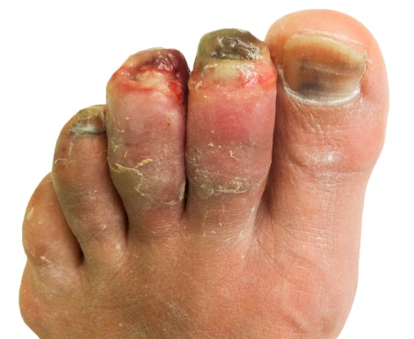
Frostbite
Frostbite
Frostbite is a serious medical condition which normally affects the extremities (fingers and toes) by causing damage to the skin due to freezing, this will eventually cause the skin to die.
Recognition
Prolonged exposure to extremely cold conditions
Pins and needles in the first stages of frostbite
Hardening and stiffening of the skin becoming painful
Skin will become purple/black and extremely painful in the later stages of frostbite
Treatment
Remove the casualty from the source of the cold
Use body heat to warm extremities (e.g. hands under arm pits)
Cover the body and extremities with blankets
Call for an ambulance immediately (999/112)

Slide 52
Heat Exhaustion
Section 3

Slide 53
Heat Exhaustion
Heat Exhaustion
Heat exhaustion is caused by the bodies core temperature rising above 37°C. In attempt to cool down, excessive sweating occurs causing the body to loose vital fluids and salts.
Recognition
Hot flushed skin
Excessive sweating
Fatigue
Headache, nausea and vomiting
Rapid pulse
Confusion
Urinating less (urine dark in colour)
Treatment
Move the casualty to a cool place
Give the casualty a sports energy drink or water to rehydrate
Remove any excessive clothing
Monitor the casualty’s response levels
Call for medical assistance (999/112)

Slide 54
Heatstroke
Section 4

Slide 55
Heatstroke
Heatstroke
Heatstroke is when the hypothalamus (the bodies temperature regulator) ceases working and the body can not cool down through normal actions such as sweating. The core temperature rises above 40°C which is very dangerous.
Recognition
High temperature and dry skin
Nausea, dizziness and vomiting
Intense headache
Lower response levels
Rapid pulse and breathing
Muscle cramps
Possibly unconscious
Treatment
Move the casualty to a cool place
Call for medical assistance immediately (999/112)
Give the casualty a sports energy drink or water to rehydrate
Try to cool the skin by applying a damp towel or spraying with water
Be prepared to carry out basic life support

Slide 56
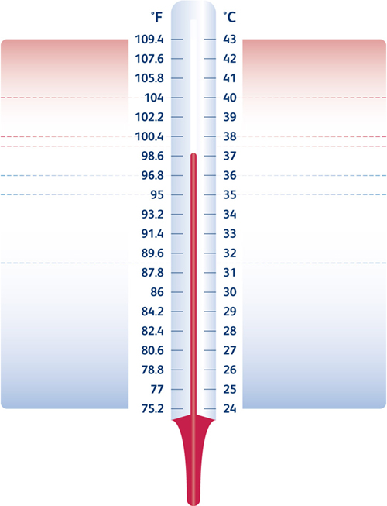
Unconsciousness / fitting
Confused / restless
Heat Stroke
Headache, dizzy, uncomfortable
Strong bounding pulse
Flushed dry skin, hot to touch
Cramps in stomach / arms / legs
Heat Exhaustion
Pale sweaty skin
Nausea / loss of appetite
Normal Body Temperature
Shivering
Fatigue, slurred speech
Confusion, forgetfulness
Mild Hypothermia
Shivering stops, muscle rigidity
Very slow, very weak pulse
Noticeable drowsiness
Severe reduction in response levels
Unconsciousness
Dilated pupils
Pulse undetectable
Severe Hypothermia
Appearance of death
Death

Slide 57
Electric shock
Section 13

Slide 58

Electric shock
Electric shocks occur when a part f the body comes into contact with a source of electricity that causes a current to pass through the skin, muscles or hair. This current will pass through the body and travel to the earth.
Electricity can be placed into two categories ‘high voltage’ and ‘low voltage’
High voltage
Do not attempt to rescue the casualty if they are within 18 metres of the source as the electricity can ‘arc’.
Keep everyone away from the source (at least 18 metres)
Contact the emergency services and electricity supplier
Low voltage
Switch the circuit breaker off that is supplying the appliance or socket
Conduct a primary survey on the child or infant
If the child or infant is unresponsive then carry out basic life support
Contact the emergency services

Slide 59
Burns and Scalds
Section 13

Slide 60
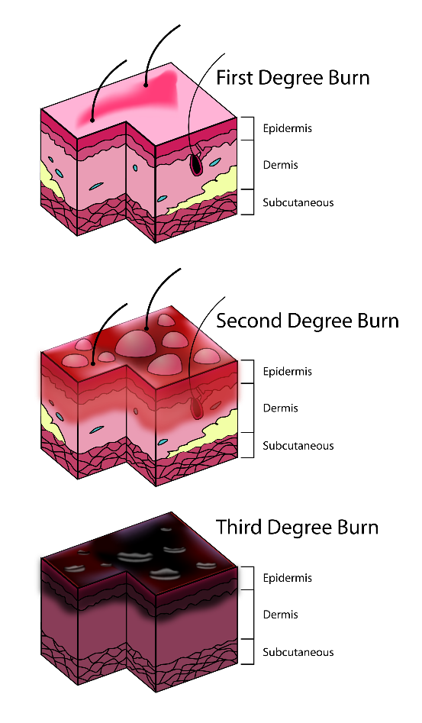
Burns and Scalds
Causes
Dry heat
Electricity
Chemicals
Extreme cold
Radiation
Burns are classified into 3 levels of severity:
Superficial burn (1st degree burn)
Partial-thickness burn (2nd degree burn)
Full-thickness burn (3rd degree burn)

Slide 61

Burns and Scalds
Superficial Burn (1st Degree Burn)
A superficial burn is where the topmost layer of skin has been burnt. A superficial burn is extremely painful as the nerve endings are sensitive
Recognition
Pain at the site of the injury
Redness, swelling and tenderness
Possible blistering
Treatment
Remove the source of heat
Wear appropriate personal protective equipment (e.g. gloves)
Cool the area of the burn with water for a minimum of 10 mins
Remove restrictive clothing and jewellery if possible
Cover the burn with a layer of cling film if possible and seek medical advice (999/112) if the burn covers more than 5% of the bodies surface

Slide 62

Burns and Scalds
Partial-thickness Burn (2nd Degree Burn)
A partial-thickness burn is where the epidermis and dermis have been burnt to varying degrees. There is a high risk of infection and possibility of the casualty going into shock.
Recognition
Skill will appear raw and swollen
Wound will be painful
Blisters that emit a clear fluid maybe present
Treatment
Remove the source of heat
Wear appropriate personal protective equipment (e.g. gloves)
Cool the area of the burn with water for a minimum of 10 mins
Remove restrictive clothing and jewellery if possible
Cover the burn with a layer of cling film if possible and seek medical assistance (999/112) if the burn covers more than 1% of the bodies surface

Slide 63

Burns and Scalds
Full-thickness Burn (3st Degree Burn)
A full-thickness burn is where all layers of the dermis and even the subcutaneous layer have been damaged. This has an very high risk if infection and shock.
Recognition
Injury will appear brown or black and often charred
Dry and leathery texture
Limited movement around the effected area
Less pain than superficial burn as nerves have been burnt away
Treatment
Remove the source of heat
Wear appropriate personal protective equipment (e.g. gloves)
Cool the area of the burn with water for a minimum of 10 mins
Remove restrictive clothing and jewellery if possible
Cover the burn with a layer of cling film if possible and seek medical assistance immediately (999/112)

Slide 64
Comfort Break

Slide 65
Poisoning
Section 14

Slide 66
Poisoning
Poison
A poison is a foreign substance that enters the body by means of ingestion inhalation, absorption or injection which will interfere the normal bodies function.
Recognition
Pains in the stomach
Impaired vision
Increased/decreased heart rate
Smell of fumes or chemicals
Burns and rashes
Nausea and vomiting
Difficulty in breathing
Treatment
Call for ambulance (999/112)
Ensure the scene is safe
Remove the cause or remove the casualty from the scene
Identify the poison if possible and provide the source to the ambulance crew when they arrive
Be prepared to carry out basic life support

Slide 67
Bites and Stings
Section 15

Slide 68
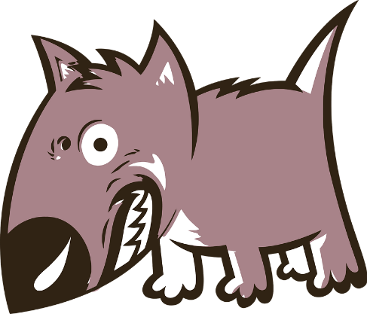
Bites and Stings
Animal and Human Bites
Serious animal and human bites can get infected if they're not checked and treated quickly.
Always seek medical advice if you have been bitten by an animal or person and the bite has broken the skin.
People and animals have a lot of bacteria in their mouths, which can cause an infection if a bite breaks the skin.
These infections are rarely serious if treated quickly, but occasionally they can spread to the blood or other parts of the body.
Serious infections such as tetanus and rabies are extremely rare in the UK, but it's important to get serious bites looked at as treatment to prevent these infections may be recommended.

Slide 69
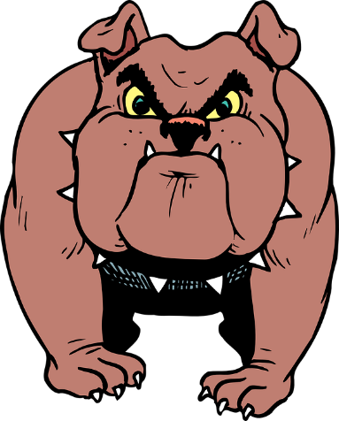
Bites and Stings
Treatment – Animal and Human Bites
Clean the wound immediately by running warm tap water over it for a couple of minutes – it's a good idea to do this even if the skin does not appear to be broken
Remove any objects from the bite, such as teeth, hair or dirt
Encourage the wound to bleed slightly by gently squeezing it, unless it's already bleeding freely
If the wound is bleeding heavily, put a clean pad or sterile dressing over it and apply pressure
Dry the wound and cover it with a clean dressing or plaster
Take painkillers if you're in pain, such as paracetamol or ibuprofen – children under 16 years old should not take aspirin
Seek medical advice, unless the wound is very minor
If the bite has severed a body part like a finger or ear, wash it with tap water, wrap it in clean tissue, and store it in a plastic bag surrounded by ice so it can be transported to hospital.

Slide 70

Bites and Stings
Insect Bites
Insect bites and stings are common and usually only cause minor irritation. However, some stings can be painful and trigger a serious allergic reaction.
Recognition
Skin around bite will appear red, swollen and itchy
Severe reactions will appear as anaphylactic shock
Treatment
Remove the sting by scraping away using hard surface such as finger nails or credit card etc. (Do not pinch or use tweezers)
Wash the affected area with soap and water
Place a cold compress (a flannel or cloth cooled with cold water) over the affected area to reduce swelling
Call 999/112 if a severe reaction occurs

Slide 71
Minor Injuries
Section 16

Slide 72
Minor Injuries
Minor Cuts and Grazes
A minor cut or graze will not bleed excessively therefore the main concern is to protect the wound from infection.
Recognition
Will not bleed excessively
Ooze blood
Sometimes very painful
Treatment
Wear appropriate personal protective equipment. (e.g. nitrile gloves)
Examine the wound for any foreign objects
Clean the effected area with a sterile cleansing wipe
Apply a sterile dressing to the wound

Slide 73
Minor Injuries
Contusion (bruises)
A bruise will often be caused by a blunt blow or a violent movement of a joint such as during a fall.
Recognition
Swelling
Blue, purple or black colouration
Probable cause associated with injury (e.g. stairs)
Treatment
Rest the area where the bruise has developed
Apply Ice
Compress the area
Elevate if possible
Think.. R I C E

Slide 74
Minor Injuries
Foreign Objects
Foreign objects can cause damage when they enter the body through wounds or orifices such as the nose or eye. You should seek medical attention unless the injury is extremely minor (e.g. surface dirt in a graze).
Ear and nose treatment
Do not attempt to remove the object
Cover with a sterile dressing
Seek medical attention (999/112) for advice

Slide 75
Minor Injuries
Splinters
Splinters are foreign objects which are embedded into the skin, these foreign objects such as; glass, wood, plastic or metal.
Treatment
Wear appropriate P.P.E. (nitrile gloves)
Examine the object to see if it is possible to remove
If possible draw the splinter out in the same direction as the entry route
If the splinter is removed, clean the surrounding area using antiseptic wipe and cover using a sterile dressing
If the object can not be removed, cover using a sterile dressing and advice casualty to
seek medical assistance.

Slide 76
Minor Injuries
Nose Bleed
Nosebleeds can be frightening, but they aren't usually a sign of anything serious and can often be treated at home or school.
Treatment
Sit down and firmly pinch the soft part of your nose, just above your nostrils, for at least 10-15 minutes
Lean forward and breathe through your mouth.
Stay upright, rather than lying down, as this reduces the blood pressure in the blood vessels of your nose and will discourage further bleeding
Call 999/112:
  If the bleeding continues for longer than 20 minutes or the bleeding is heavy and the casualty lost a lot of blood
  If the casualty has difficulty breathing
  If the casualty has swallowed a large amount of blood that makes them vomit

Slide 77
Reporting of Injuries, Illnesses and Emergencies
Section 17

Slide 78
Reporting of Injuries, Illnesses and Emergencies
Gathering Patient Information
Whilst communicating with the casualty it is important to gather as much information about them and the situation as possible, this will help you the first aider as well as the emergency services when they arrive.
The best way to gather information is to look at the casualties:
History – uncover as much information about the casualty as possible, information such as; time, location, nature of the accident, witnesses and injuries sustained. It is also important to find out if the casualty is taking any prescribed medication and a history of similar injuries or conditions.
Signs – what you as the first aider can see, smell or hear.
Symptoms – what the casualty actually feels such as any pain or feeling nauseous or weak.

Slide 79
Reporting of Injuries, Illnesses and Emergencies
Gathering Patient Information
W - What happened
H - How did it happen
A - Are they wearing a medical alert bracelet?
T - The time of the accident/incident
S - Sign of injury
K - Known medication/previous injuries/allergies
E - Eating time of last meal
Y - You now need to conduct a secondary survey

Slide 80
Reporting of Injuries, Illnesses and Emergencies
Incident Recording and Reporting
After any first aid incident it is important the incident is recorded and reported in full.
Ultimately the employer is responsible for the reporting of accidents however you should be clear on your role as the first aider in this process.
The accident book should be completed in full and populated with clear and concise information. There may also be the necessity to report the incident under ‘R. I. D. D. O. R.’.
In cases where a public access AED has been used, there may be a requirement to report the event to your local authority or ambulance service.

Slide 81
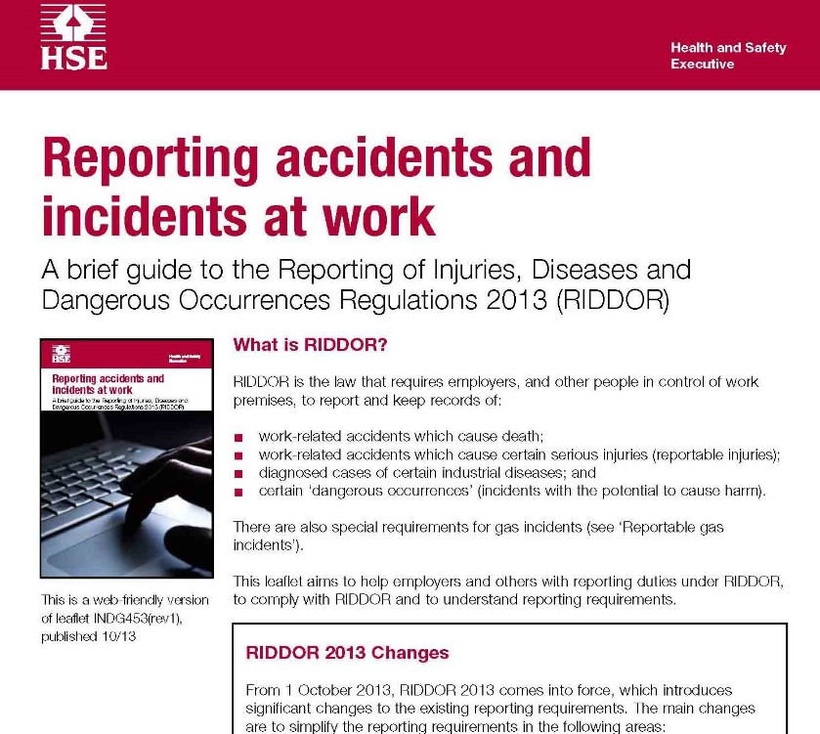
Reporting of Injuries, Illnesses and Emergencies
Reporting of Injuries, Diseases and Dangerous Occurrence Regulations (R. I. D. D. O. R.)
R. I. D. D. O. R. is the law that requires employers, and other people in control of work premises, to report and keep records of:
Work-related accidents which cause death.
Work-related accidents which cause certain serious injuries (reportable injuries).
Diagnosed cases of certain industrial diseases.
Certain ‘dangerous occurrences’ (incidents with the potential to cause harm).

Slide 82
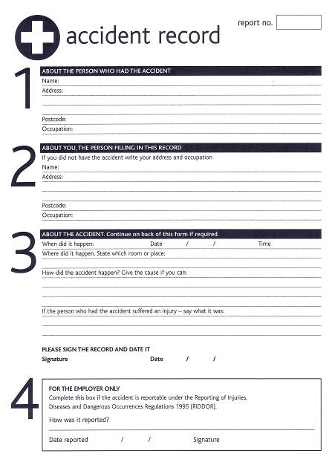
Reporting of Injuries, Illnesses and Emergencies
Accident Form
The accident form should be filled out with as much detail as possible relating to the incident, including:
Who was involved
Specific details of the incident and injury
Witnesses present

Slide 83



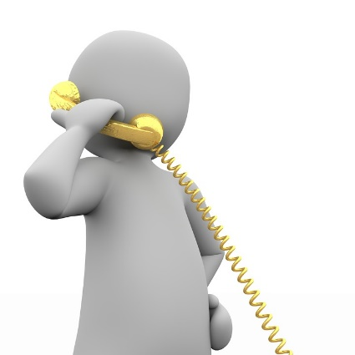
Reporting of Injuries, Illnesses and Emergencies
Contacting the Child Protection Services
Why contact your Local Authority Child Protection Officer?
Other contacts:

Slide 84
Comfort Break

Slide 85
Summative Assessment

Slide 86
Thank you
Please complete your evaluation form located in your learner pack.
Please retain your learner pack for your reference and only return the evaluation form to your tutor.

