Slide 1
First Aid at Work
(Level 3)
Day 2
Course tutor: _______________________

Slide 2
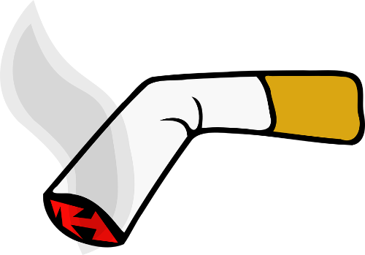
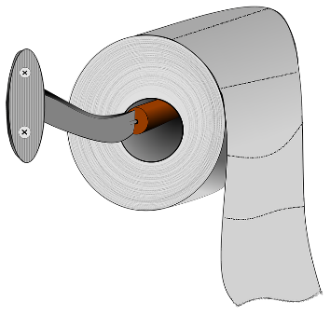
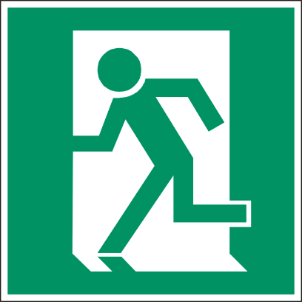
House Keeping
Fire Exits
Toilets
Smoking areas
Mobile phones
Schedule for today

Slide 3
Learning Outcomes
By the end of the session you will:
Be able to conduct a secondary survey.
Be able to administer first aid to a casualty with anaphylaxis.
Be able to administer first aid to a casualty with injuries to bones, muscles and joints.
Be able to administer first aid to a casualty with suspected head and spinal injuries.
Be able to administer first aid to a casualty with suspected chest injuries.
Be able to provide first aid to a casualty with a suspected major illness.

Slide 4
Anaphylaxis
Section 1

Slide 5
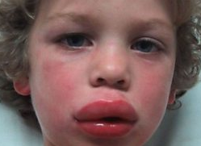
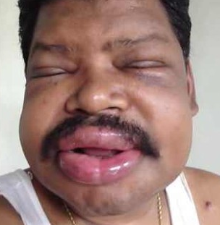
Anaphylaxis
Anaphylaxis
Anaphylaxis is an extreme allergic reaction which has the potential to be life threatening. It results in rapid chemical changes in the body and can be caused by a trigger such as; insect stings, foods and medicines.
Recognition
Swelling of the mouth, tongue, face and neck
Difficulty breathing
Red, blotchy and itchy skin
Nausea
Anxiety

Slide 6
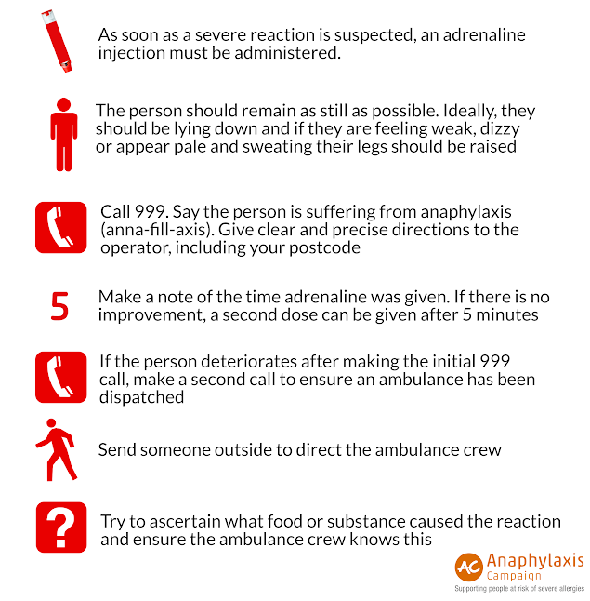
Anaphylaxis

Slide 7
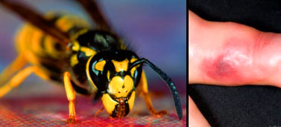
Anaphylaxis
Insect Bites
Insect bites and stings are common and usually only cause minor irritation. However, some stings can be painful and trigger a serious allergic reaction.
Recognition
Skin around bite will appear red, swollen and itchy
Severe reactions will appear as anaphylactic shock
Treatment
Remove the sting by scraping away using hard surface such as finger nails or credit card etc. (Do not pinch or use tweezers)
Wash the affected area with soap and water
Place a cold compress (a flannel or cloth cooled with cold water) over the affected area to reduce swelling
Call 999/112 if a severe reaction occurs

Slide 8
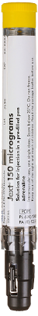

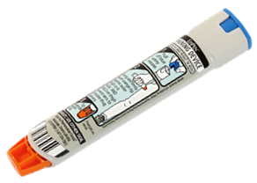
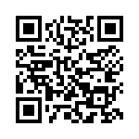
Anaphylaxis
Epipen
Reference:
EpiPen & ASCIA Education Resources

Slide 9
Minor Injuries
Section 2

Slide 10
Minor Injuries
Minor Cuts and Grazes
A minor cut or graze will not bleed excessively therefore the main concern is to protect the wound from infection.
Recognition
Will not bleed excessively
Ooze blood
Sometimes very painful
Treatment
Wear appropriate personal protective equipment. (e.g. nitrile gloves)
Examine the wound for any foreign objects
Clean the effected area with a sterile cleansing wipe
Apply a sterile dressing to the wound

Slide 11
Minor Injuries
Contusion (bruises)
A bruise will often be caused by a blunt blow or a violent movement of a joint such as during a fall.
Recognition
Swelling
Blue, purple or black colouration
Probable cause associated with injury (e.g. stairs)
Treatment
Rest the area where the bruise has developed
Apply Ice
Compress the area
Elevate if possible
R I C E

Slide 12
Minor Injuries
Foreign Objects
Foreign objects can cause damage when they enter the body through wounds or orifices such as the nose or eye. You should seek medical attention unless the injury is extremely minor (e.g. surface dirt in a graze).
Ear and nose treatment
Do not attempt to remove the object
Cover with a sterile dressing
Seek medical attention (999/112) for advice

Slide 13
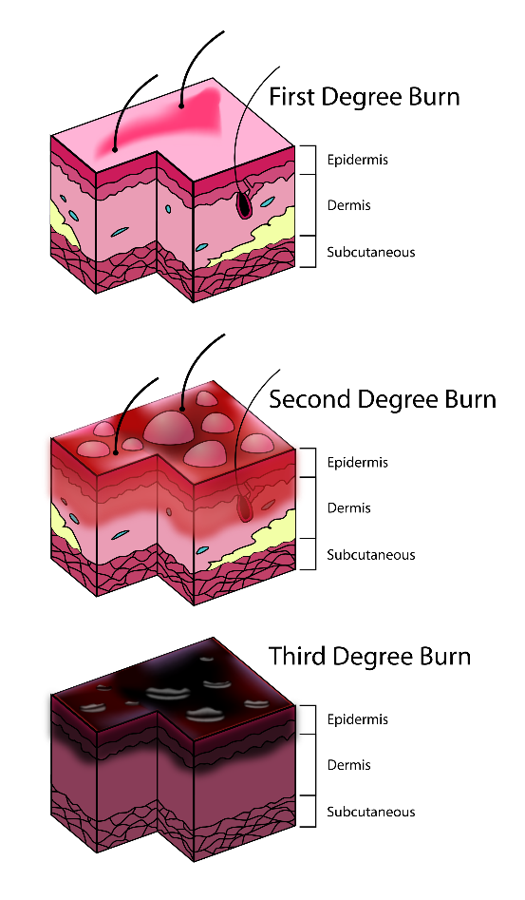
Minor Injuries
Burns and Scalds
Causes
Dry heat
Electricity
Chemicals
Extreme cold
Radiation
Burns are classified into 3 levels of severity:
Superficial burn (1st degree burn)
Partial-thickness burn (2nd degree burn)
Full-thickness burn (3rd degree burn)

Slide 14

Minor Injuries
Superficial Burn (1st Degree Burn)
A superficial burn is where the topmost layer of skin has been burnt. A superficial burn is extremely painful as the nerve endings are sensitive
Recognition
Pain at the site of the injury
Redness, swelling and tenderness
Possible blistering
Treatment
Remove the source of heat
Wear appropriate personal protective equipment (e.g. gloves)
Cool the area of the burn with water for a minimum of 10 mins
Remove restrictive clothing and jewellery if possible
Cover the burn with a layer of cling film if possible and seek medical advice (999/112) if the burn covers more than 5% of the bodies surface

Slide 15

Minor Injuries
Partial-thickness Burn (2nd Degree Burn)
A partial-thickness burn is where the epidermis and dermis have been burnt to varying degrees. There is a high risk of infection and possibility of the casualty going into shock.
Recognition
Skill will appear raw and swollen
Wound will be painful
Blisters that emit a clear fluid maybe present
Treatment
Remove the source of heat
Wear appropriate personal protective equipment (e.g. gloves)
Cool the area of the burn with water for a minimum of 10 mins
Remove restrictive clothing and jewellery if possible
Cover the burn with a layer of cling film if possible and seek medical assistance (999/112) if the burn covers more than 1% of the bodies surface

Slide 16

Minor Injuries
Full-thickness Burn (3st Degree Burn)
A full-thickness burn is where all layers of the dermis and even the subcutaneous layer have been damaged. This has an very high risk if infection and shock.
Recognition
Injury will appear brown or black and often charred
Dry and leathery texture
Limited movement around the effected area
Less pain than superficial burn as nerves have been burnt away
Treatment
Remove the source of heat
Wear appropriate personal protective equipment (e.g. gloves)
Cool the area of the burn with water for a minimum of 10 mins
Remove restrictive clothing and jewellery if possible
Cover the burn with a layer of cling film if possible and seek medical assistance immediately (999/112)

Slide 17
Minor Injuries
Sprains and Strains
A sprain or strain attributed to activity or playing sport. It is caused by a sharp movement or overstretch to a muscle or joint.
Recognition
Pain, bruising and swelling
Loss of movement
Cramps to muscle
Treatment
Rest the area where the bruise has developed
Apply Ice
Compress the area
Elevate if possible
R. I. C. E.

Slide 18
Minor Injuries
Splinters
Splinters are foreign objects which are embedded into the skin, these foreign objects such as; glass, wood, plastic or metal.
Treatment
Wear appropriate P.P.E. (nitrile gloves)
Examine the object to see if it is possible to remove
If possible draw the splinter out in the same direction as the entry route
If the splinter is removed, clean the surrounding area using antiseptic wipe and cover using a sterile dressing
If the object can not be removed, cover using a sterile dressing and advice casualty to
seek medical assistance.

Slide 19
Fractures and Dislocations
Section 3

Slide 20
Fractures and Dislocations
Fracture
A fracture is a chip, crack or break in a bone.
Recognition
Pain, swelling, tenderness and bruising around the site of the injury
Associated bleeding possible in open fractures
Loss of mobility
Nausea, pale, cold clammy skin
Treatment
Wear appropriate P.P.E. (e.g. nitrile gloves)
Treat any bleeding
Immobilise the bone in the position that it is found and most comfortable
Call for an ambulance (999/112)

Slide 21
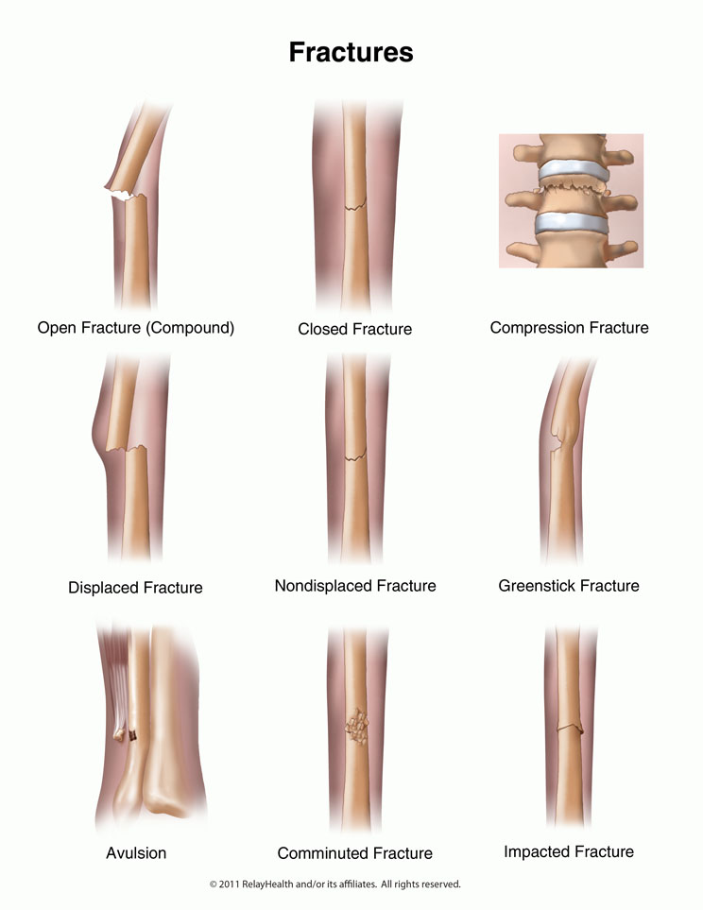
Fractures and Dislocations
Fracture
Fractures are classed into the following:
Closed – bone has fractured but has not penetrated the skin.
Open – bone has fractured and penetrated the skin, this has a high risk of infection and bleeding.
Complicated – bone has shattered or broken up internally causing further damage to tendons, blood vessels or organs if moved.
Green stick – cracking or splintering of the bone.

Slide 22
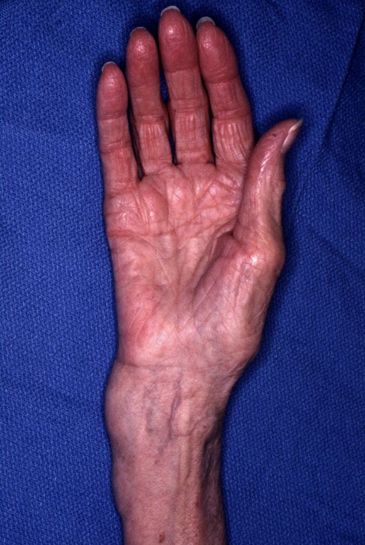
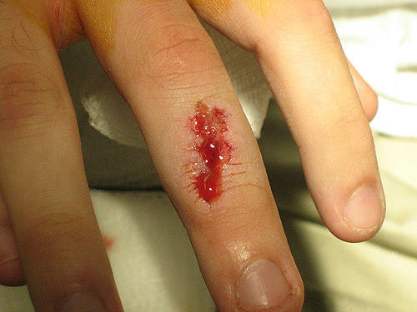
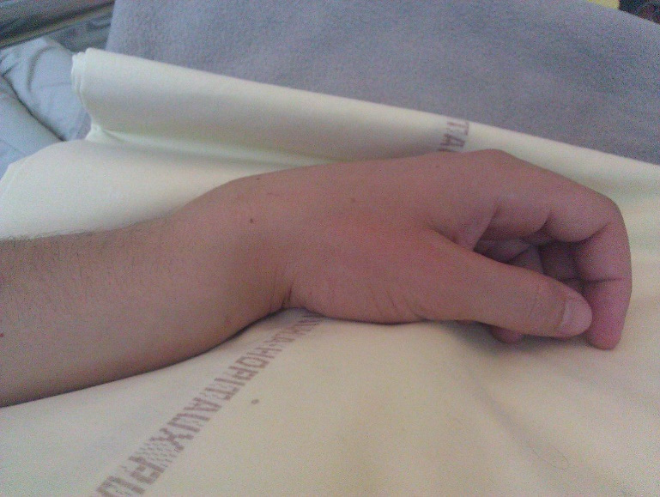
Fractures and Dislocations
Example of Fractures

Slide 23
Fractures and Dislocations
Dislocation
A dislocation occurs when a joint becomes displaced or misaligned. A dislocations are often caused by a sudden impact to the joint.
Recognition
Pain, redness and swelling
Loss of movement
Deformity
Treatment
Immobilise and support in the position found
Allow the casualty to get in a comfortable position
Call for medical assistance (999/112)
Treat for shock if necessary

Slide 24
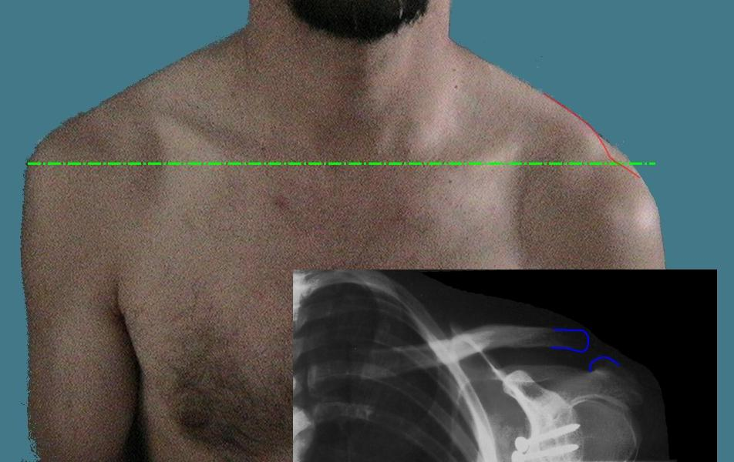
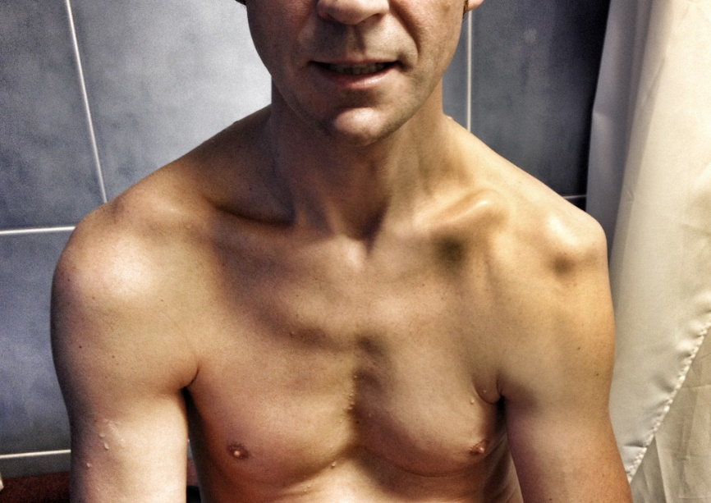
Fractures and Dislocations
Example of Dislocations

Slide 25
Spinal Injuries
Section 4

Slide 26
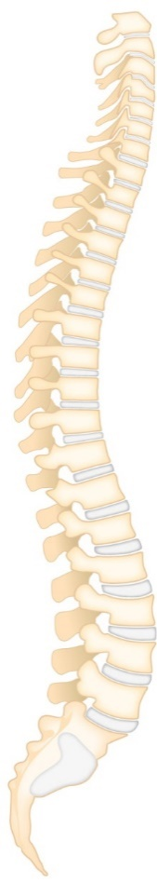
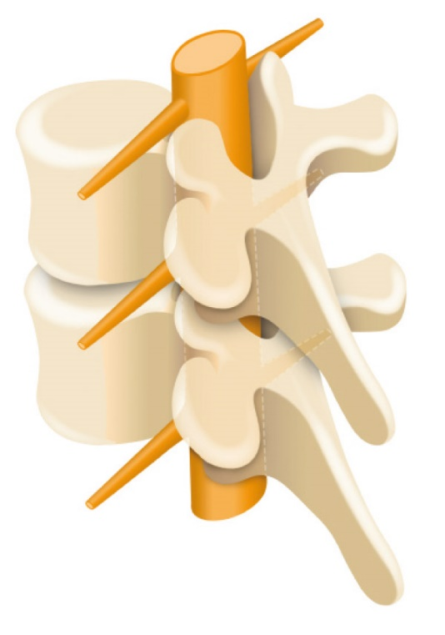
Fractures and Dislocations
Spinal Injury
Spinal injuries are very serious as the they may cause paralysis or even death.
7 Cervical
12 Thoracic
5 Lumbar
5 Fused Sacral

Slide 27
Fractures and Dislocations
Spinal Injury
Spinal injuries are very serious as the they may cause paralysis or even death.
Recognition
Unusual position of the head or body
Pain at the site of the injury
Lack of mobility
Weakness and tingling sensations
Loss of bowl or bladder control
Signs of shock
Treatment
Call for medical assistance (999/112)
Keep the casualty in the position that you found them and immobilise the head and neck
Reassure the casualty and ask them to remain still
Keep the casualty warm
Keep monitoring the casualties airway and breathing
Be prepared to perform basic life support

Slide 28
Head Injuries
Section 5

Slide 29
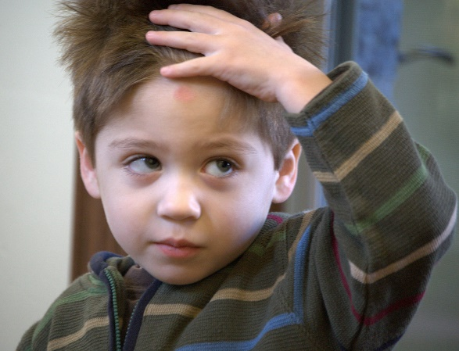
Head Injuries
Head Injury
Head injuries have the potential to be life threatening and therefore casualties should always be examined by qualified medical personnel.
Head injuries are classes into the following:
Concussion
Compression
Fractured skull
Stroke

Slide 30
Head Injuries
Concussion
Concussion is the shaking of the brain caused by a blow to the head which causes a temporary disturbance of normal brain activity.
Recognition
Possible loss of consciousness
Dizziness and nausea
Headache
Brief loss of memory
Blurred vision
Treatment
Treat any bleeding
Call for medical assistance (999/112)
Lay the casualty down on a flat surface and raise the head and shoulders
Monitor the casualty and be prepared to carry out basic life support

Slide 31
Head Injuries
Compression
Compression is a build up of pressure on the brain caused by accumulation of blood or swelling.
Recognition
Intense headache
Drowsiness
Unequal pupil sizes
Slow, strong pulse
Weakness or paralysis down one side of the body
Noisy breathing
Treatment
Treat any bleeding
Call for medical assistance (999/112)
Lay the casualty down on a flat surface and raise the head and shoulders
Monitor the casualty and be prepared to carry out basic life support

Slide 32
Head Injuries
Fractured Skull
Can ether be open or closed; caused by a blow to the head.
Recognition
Associated wound
Tenderness and pain
Depression or deformity of the skull
Bruising and swelling at the site of the injury
Presence of cerebral spinal fluid from ears and nose
Treatment
Treat any bleeding
Call for medical assistance (999/112)
Lay the casualty down on a flat surface and raise the head and shoulders
Monitor the casualty and be prepared to carry out basic life support

Slide 33
Head Injuries
Stroke
A stroke is ether short term or permanent damage to the brain and body. If you suspect a stroke you must act FAST.
Recognition
FACE – has the face dropped on one side
ARM – can the person raise both arms?
SPEECH – can the person speak clearly and understand what you say?
TIME to call 999/112 – early treatment can help prevent further damage
Treatment
Call for an ambulance immediately (999/112)
Lay casualty down with head and shoulders raised
If unconscious place in recovery position
Loosen any restrictive clothing
Monitor airway and breathing and be prepared to perform basic life support

Slide 34
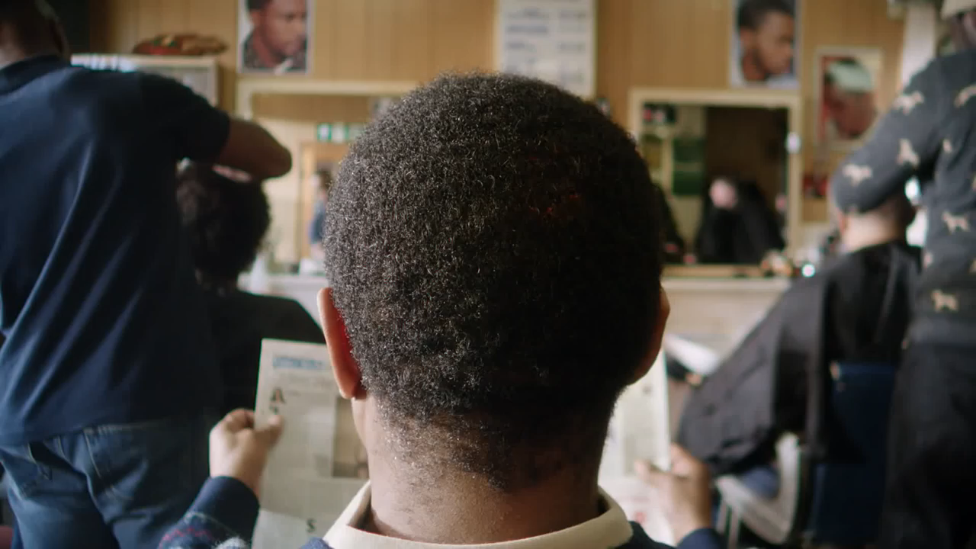
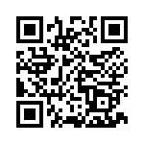
Head Injuries
Stroke
Reference:
NHS & Stroke Association

Slide 35
Comfort Break

Slide 36
Chest Injuries
Section 6

Slide 37
Chest Injuries
Types of Chest Injury
Chest injuries are serious injuries and can be life threatening.
Types of chest injuries include:
Rib fracture
Flail chest
Penetrating chest wound

Slide 38
Chest Injuries
Rib Fracture
Fractures of ribs can cause severe pain and panic. Middle ribs are more commonly broken or fractured.
Recognition
Pain when breathing or moving
Grating sound when moving or breathing
Treatment
Allow the casualty to adopt the most comfortable position
Seek medical attention immediately

Slide 39
Chest Injuries
Flail Chest
Flail chests is a life threatening condition, are caused by blunt trauma or underlying medical conditions. It occurs when a segment of the ribcage breaks under extreme stress which then becomes detached from the rest of the chest wall.
Recognition
Pain and bruising
Grazes and sign of seat belt trauma
Palpitations
Treatment
Protect the underlying lung
Minimise movement
Call for an ambulance immediately (999/112)

Slide 40
Chest Injuries
Penetrating Chest Wound
Caused by gun shot, knife wound or other sharp objects which could penetrate the chest. Id there is a hole in the chest wall, air enters the cavity with each breath and becomes trapped. This trapped air builds up pressure as the amount increases and may collapse the lung causing severe breathing problems.
Recognition
Visible open wound
Sucking sound as the air enters the chest
Difficulty breathing
Blood bubbling from the wound
Casualty maybe coughing up blood
Treatment
Call an ambulance immediately (999/112)
Wear appropriate P.P.E (e.g. nitrile gloves)
Do not remove embedded objects
Lay the casualty in a comfortable position and leave the chest wound open and exposed. Control localised bleeding with direct pressure
Treat for shock and be prepared to perform basic life support

Slide 41
Heart Attack
Section 7

Slide 42
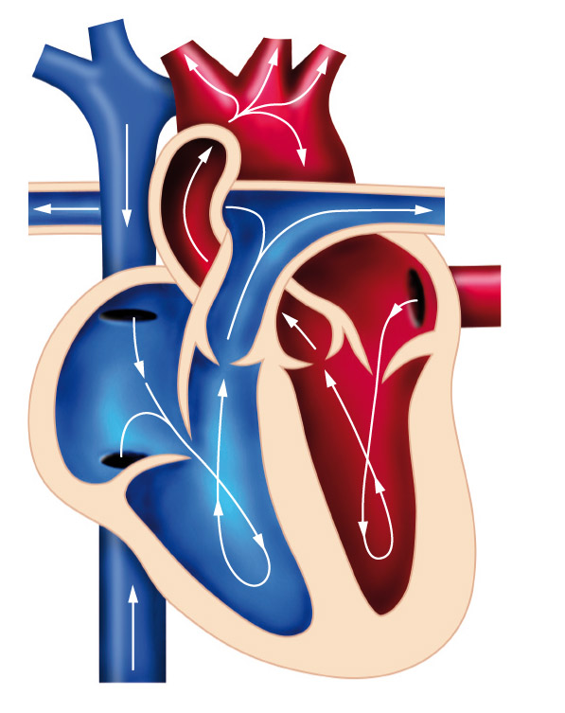
Heart Attack
The Heart
From the body
To the lungs
To the lungs
From the body

Slide 43
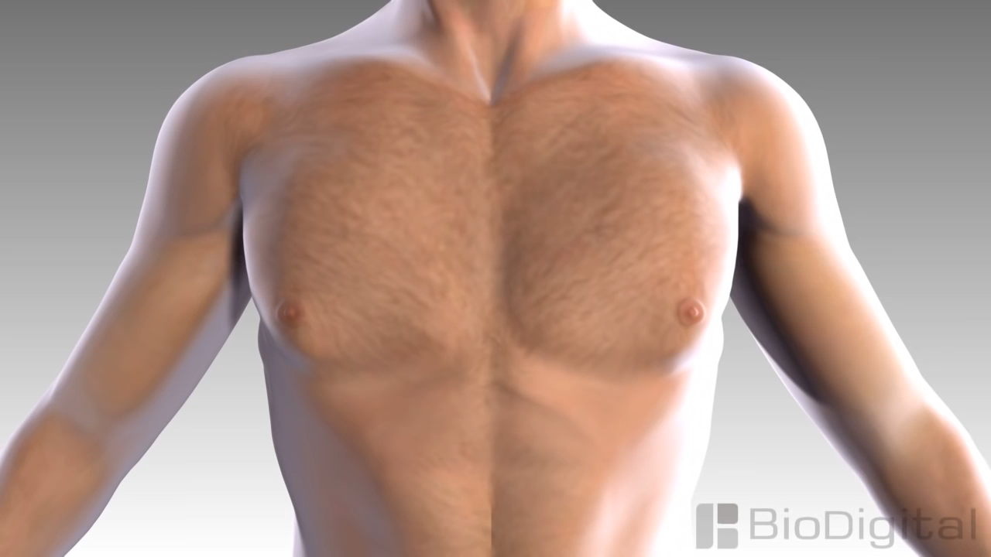
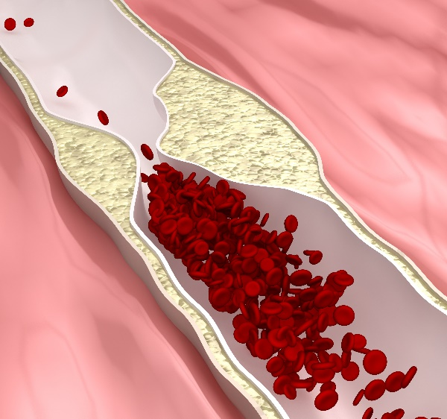
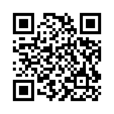
Heart Attack
Heart Attack
A heart attack occurs when the coronary arteries which supply the heart with oxygen has become blocked. This causes a section of the heart to start to die. The heart will therefore not work effectively to supply blood to the rest of the body.
Reference:
BioDigital Inc.

Slide 44

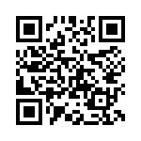
Heart Attack
Reference:
BBC & ArrhythmiaAlliance

Slide 45
Heart Attack
Heart Attack
Recognition
Tightness and/or pain in the chest (mild or severe)
Casualty clutching the chest
Possible spreading of pain to the arms, neck and back
Dizziness or light headed feeling
Possible shortness of breath
Nausea, sick and have cold sweats
Treatment
Call for an ambulance immediately (999/112)
Sit the casualty down with knees raised in a W-position
Loosen any restrictive clothing, keep the casualty warm and comfortable
Monitor the casualties airway and breathing and be prepared to perform basic life support

Slide 46
Angina
Section 8

Slide 47
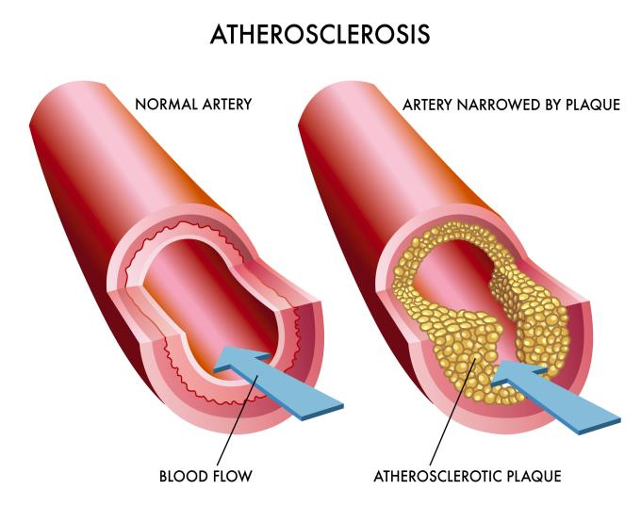
Angina
Angina
Recognition
Tightness and/or pain in the chest (mild or severe)
Casualty clutching the chest
Possible spreading of pain to the arms, neck and back
Possible shortness of breath
Nausea, sick and have cold sweats
Only lasts up to 15 minutes unlike a heart attack

Slide 48
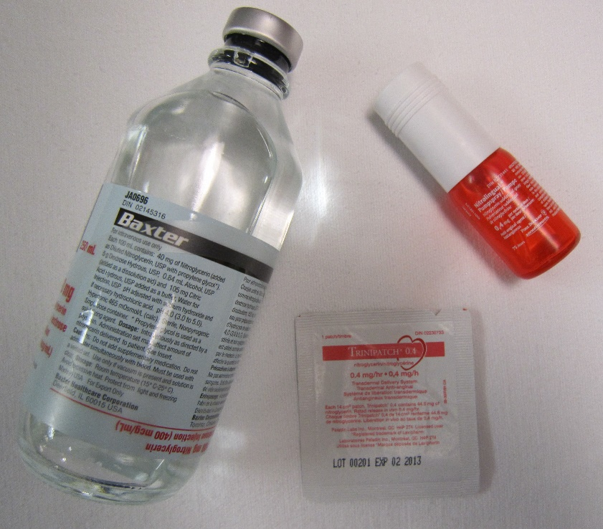
Angina
Angina
Treatment
Call for an ambulance immediately (999/112)
Sit the casualty down with knees raised in a W-position
Loosen any restrictive clothing, keep the casualty warm and comfortable
Ask casualty for their history and ascertain if they have been diagnosed with angina
Encourage them to take their medication (usually GTN spray, Glyceryl trinatrate)
Monitor the casualties airway and breathing and be prepared to perform basic life support

Slide 49
Angina
Heart Attack
Onset
Sudden, usually during exertion, stress or extreme weather.
Sudden, can occur at rest.
Pain
Vice-like squashing pain.
‘Dull’, ‘tightness’ or ‘pressure’.
Can be mistaken for indigestion.
Vice-like squashing pain.
‘Dull’, ‘tightness’ or ‘pressure’.
Can be mistaken for indigestion.
Location of Pain
Central chest. Can radiate into
arms, neck, jaw, back, shoulders.
Central chest. Can radiate into arms, neck, jaw, back, shoulders.
Duration
3 – 8 Minutes, rarely longer.
Usually longer than 30 minutes.
Skin
Pale, may be sweaty.
Pale, grey colour. May sweat profusely.
Pulse
Variable. Often becomes
irregular, missing beats.
Variable. Often becomes
irregular, missing beats.
Other signs and symptoms
Shortness of breath,
weakness, anxiety.
Shortness of breath, dizziness, nausea, vomiting, sense of ‘impending doom’.
Factors giving relief
Resting, reducing stress,
taking ‘GTN’ medication.
GTN medication may give
partial or no relief.

Slide 50
Hypoglycaemia and Hyperglycaemia
Section 9

Slide 51
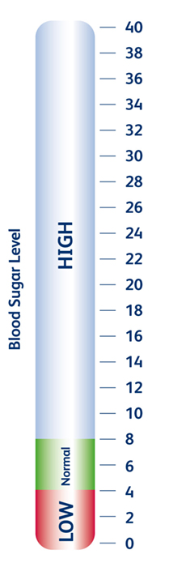
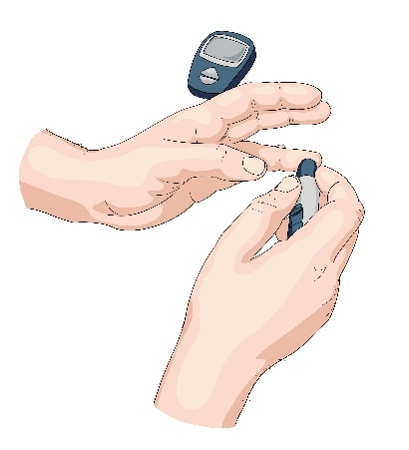

Hypoglycaemia and Hyperglycaemia
Diabetes
Diabetes is caused by a failures of the bodies ability to produce insulin which regulates the blood sugar levels.
Insulin
Sugar

Slide 52
Hypoglycaemia and Hyperglycaemia
Hypoglycaemia
This is caused when the blood sugar level is too low.
Recognition
Blurred vision
Hunger
Tired, confused and feeling faint
Increased heart rate
Headache
Tingling sensations
Noticeable change in personality
Treatment
Sit the casualty down, calm and reassure
Ask the casualty to take a 15 – 20g glucose tablet, sugar or sugary drink
If there is no improvement in the casualties condition call for an ambulance (999/112)
Monitor the casualties condition, if the casualty becomes unconscious be prepared to carry out basic life support

Slide 53
Hypoglycaemia and Hyperglycaemia
Hyperglycaemia
This is caused when the blood sugar level is too high.
Recognition
Sweet fruity smelling breath
Increased need to urinate
Increased thirst
Dry mouth
Loss of appetite
Tiredness and confused
Treatment
Sit the casualty down, calm and reassure
Encourage the casualty to use their medication
If they have not been previously been diagnosed with diabetes then call form medical assistance (999/112)
Monitor the casualties condition, if the casualty becomes unconscious be prepared to carry out basic life support

Slide 54
Poisoning
Section 10

Slide 55
Poisoning
Poison
A poison is a foreign substance that enters the body by means of ingestion inhalation, absorption or injection which will interfere the normal bodies function.
Recognition
Pains in the stomach
Impaired vision
Increased/decreased heart rate
Smell of fumes or chemicals
Burns and rashes
Nausea and vomiting
Difficulty in breathing
Treatment
Call for ambulance (999/112)
Ensure the scene is safe
Remove the cause or remove the casualty from the scene
Identify the poison if possible and provide the source to the ambulance crew when they arrive
Be prepared to carry out basic life support

Slide 56
Asthma
Section 11

Slide 57
Asthma
Asthma
Asthma is a condition that affects the airway by inflaming it making it difficult to breathe. There are many triggers of asthma which include; dust, pollen and pet hair.
Recognition
Breathlessness
Wheezing
Tightness around the chest
Bouts of coughing
Cyanosis (blue lips, ears and nose)
May be unconscious
Treatment
Sit the casualty down on a chair or floor away from the cause of the attack and let them get in a comfortable position
Encourage the casualty to take their medication (inhaler)
Calm and reassure the casualty
If the attack is prolonged call for medical assistance (999/112)
Be prepared to carry out basic life support

Slide 58


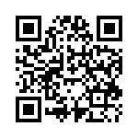
Asthma
Asthma
Salbutamol inhalers (blue) can now be kept in educational establishments first aid boxes, provided they follow the guidance.
Reference:
NHS Nottingham City Clinical Commissioning Group

Slide 59
Asthma
Hyperventilation (HVS)
Hyperventilation syndrome (HVS) is a name given to a collection of physical and emotional symptoms, largely brought about by hyperventilation. This happens when we over-breathe.
Recognition
Breathlessness / fast breathing
Tightness around the chest
Tingling (e.g. in fingers, arms, mouth)
Muscle stiffness
Trembling in hands
Dizziness, blurred vision, faintness
Headaches
Treatment
Sit the casualty down on a chair or floor and let them get in a comfortable position
Calm and reassure the casualty
Encourage the casualty to slow their breathing
If the attack is prolonged call for medical assistance (999/112)

Slide 60
Comfort Break

Slide 61
Casualty Handling and Secondary Survey
Section 12

Slide 62
Casualty Handling and Secondary Survey
D. R. A. B. C. D. (Primary Survey) - Recap
Danger
Response
Airway
Breathing
Call 999 / Circulation
Defibrillation
Prior to approaching the casualty, ensure the safety of the casualty, yourself and any bystanders.
Check the casualty for response by asking the casualty if they are ok and tap them on their shoulder.
Place the casualty on their back. Open the airway using the head tilt and chin lift method.
Place your cheek next to the casualties mouth; look, listen and feel for normal breathing for 10 seconds.
Ask a helper to call for medical assistance.
Send someone to get an AED if available and start CPR.
If an AED arrives, switch it on and follow the prompts.
An AED is used in conjunction with CPR.

Slide 63
Casualty Handling and Secondary Survey
Prioritising the Treatment of the Casualties - Recap
After conducting a primary survey and contacting the emergency services, casualties should be placed in an order of priority and treated accordingly. This order is as follows:
Breathing
Bleeding
Bones or Burns
Other conditions

Slide 64
Casualty Handling and Secondary Survey
Level of Consciousness - Recap
The Glasgow coma scale (GCS) is how medical professionals determine how conscious a casualty is. A simplified version of this is as follows:
A
V
P
U
Alert
Voice
Command
Question
Pain
When touched
When moved
Unresponsive

Slide 65
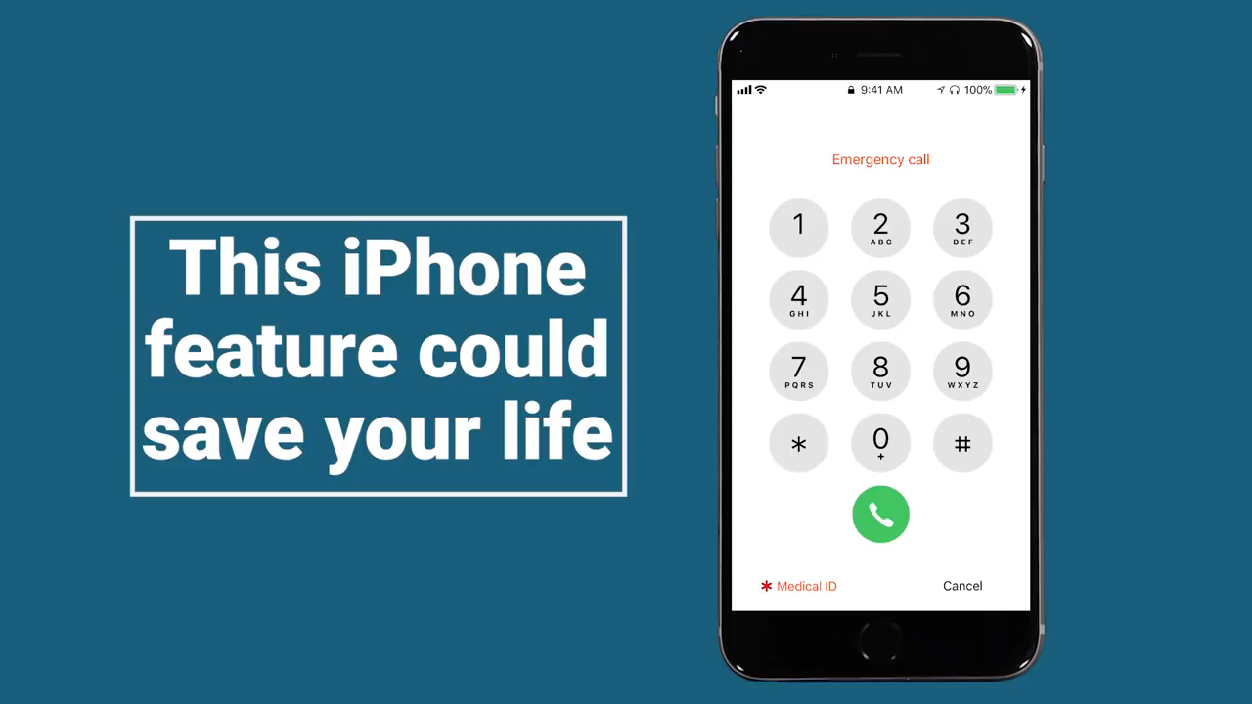
Emergency Medical Information – Mobile Devices

Slide 66
Casualty Handling and Secondary Survey
Secondary Survey
If the casualty is breathing normally after you check for breathing in your primary survey you should contact the emergency services and then perform a secondary survey.
This examination will help you as the first aider gather more information from the casualty.
Talk to the casualty throughout the survey to reassure them and to tell you if they have any pain or discomfort.

Slide 67
Casualty Handling and Secondary Survey
Secondary Survey
Head and Face
Inspect the casualties head looking for obvious signs of injury.
Remove spectacles and gently feel around the head and face for any bleeding, swelling or depressions.
Look in the ears and nose for signs of bleeding or the presence of cerebrospinal fluid (CSF).
Gently open the eye lids together and check the pupils for any reaction to light.
Smell the breath for any distinct odours e.g. alcohol.
Feel the forehead with the back of your hand to check temperature – does it feel normal?

Slide 68
Casualty Handling and Secondary Survey
Secondary Survey
Neck
Loosen any restrictive clothing.
Gently feel around the back of the neck and spinal area to check for bleeding, swelling or deformity.
Check for medical alert necklaces.
Take the pulse in the neck quickly – Is it fast, slow, irregular? What does this information tell you?

Slide 69
Casualty Handling and Secondary Survey
Secondary Survey
Chest and Shoulders
Gently feel around the shoulders to check for signs of deformity and bleeding.
Check the chest for signs of deformity and bleeding.
Abdomen
Gently check the abdomen for signs of bleeding, swelling or unnatural softness.
If you suspect the casualty has any of the above check the stomach for any bruising if possible.

Slide 70
Casualty Handling and Secondary Survey
Secondary Survey
Spine
Check as much of the spine as possible without moving the casualty.
Feel for any tenderness or deformity as well as signs of bleeding.
Pelvis
Check the hips and pelvis for deformity, unnatural positioning or bleeding.

Slide 71
Casualty Handling and Secondary Survey
Secondary Survey
Legs and Feet
Check the legs and feet for bleeding, unnatural positioning, swelling and deformity.
Check the pockets for any form of identification, mobile devices which could be used to contact the emergency services, medication or any other object which may cause discomfort when moving them.
Arms and Hands
Check down the arms feeling for any deformity, bleeding or swelling.
Check wrists for any medical alert bracelets or tattoos.
Check wrists and in between fingers for puncture marks from injections.

Slide 72
Tutor Demonstration and Learner Practice
Check for dangers
Check for response
Roll the casualty from front to back
Check the casualties airway
Check the casualty is breathing
Conduct a secondary survey
Action as if the casualty was vomiting
Recovery position

Slide 73
Summative Assessment

Slide 74
Thank you

